Slide 1
Considering Data Center Development in Iowa
A Practical Discussion for Iowa Leaders
& Practitioners
October 16, 2026
ECICOG Data Centers for Local Governments 101

Slide 2

Roadmap for Today’s Presentation
How and why a Decision Tool? Six topics:
  Community Considerations
  Siting and Zoning
  Potable Water & Wastewater
  Energy
  Incentives and Economic Development
  Thinking Ahead: Construction Phase
“Best Practices”
Q&A

Slide 3

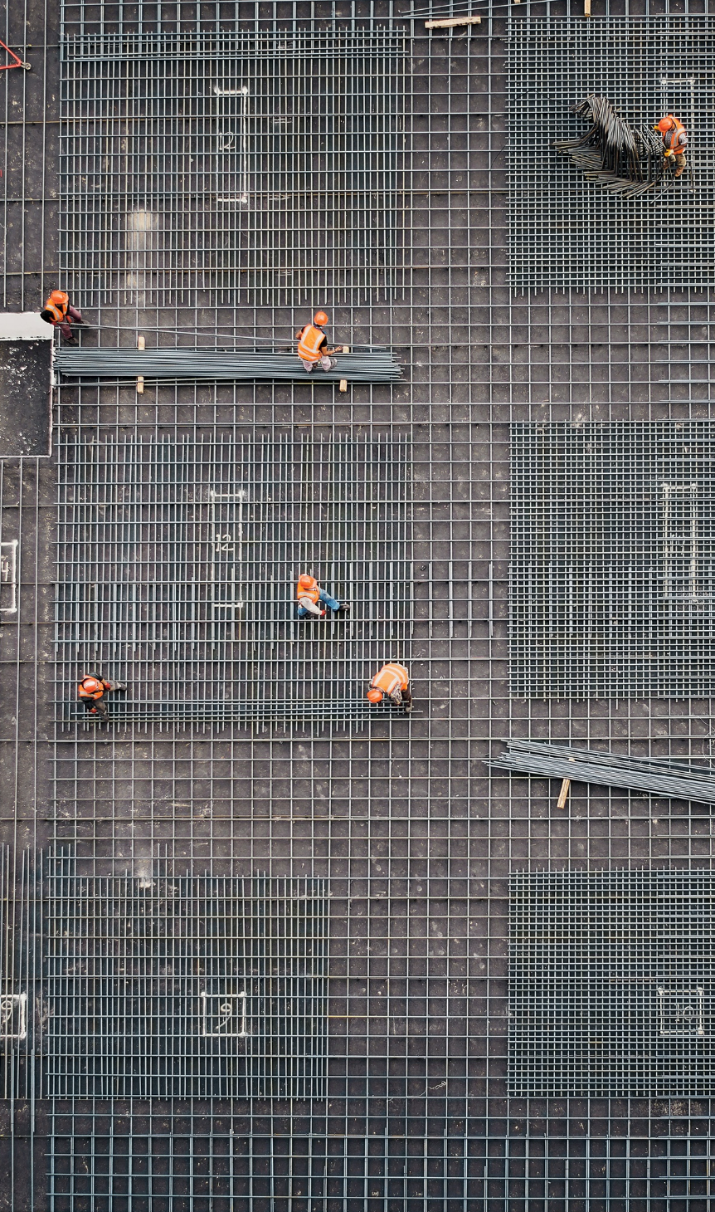
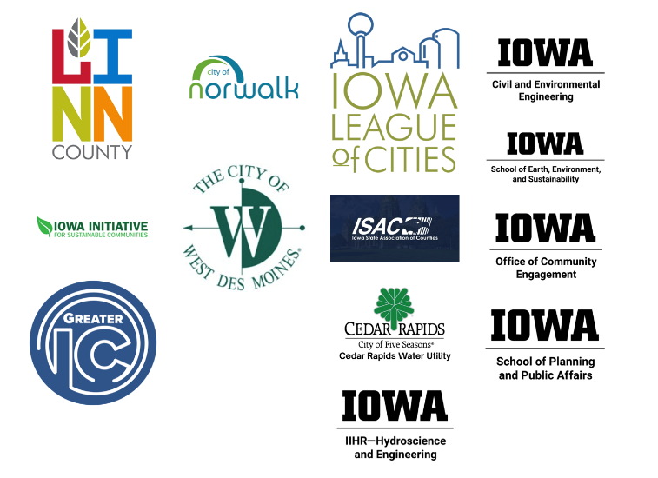
Introduction
Made by and for Iowans
Driven by need for information across the state
Community collaborators from varying data center development perspectives

Slide 4
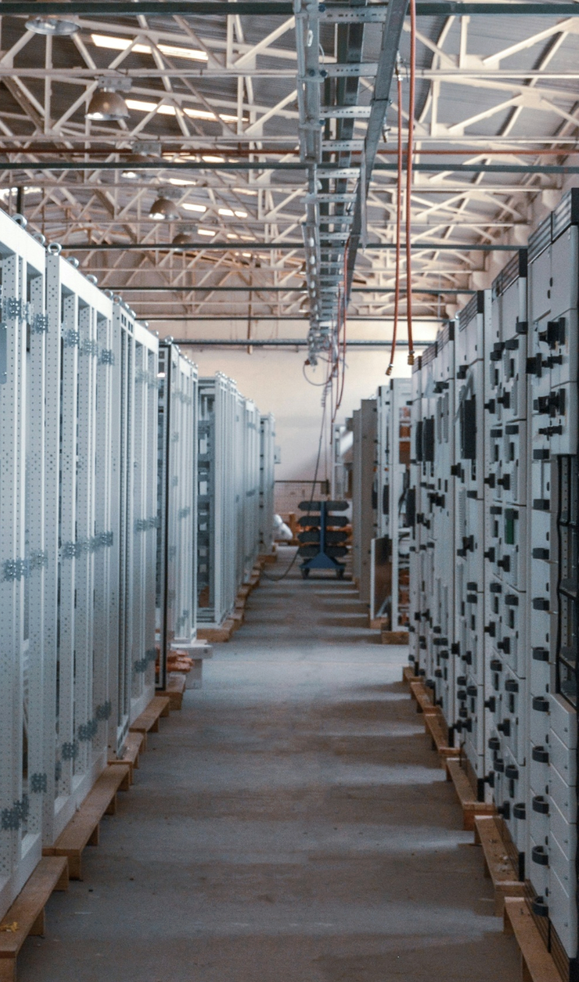
Community Considerations
When and how to engage with residents to assess perspectives?
How will community perspectives be assessed and weighed
  E.g., what if surveys and public comment indicate most residents do not favor development?
Could infrastructure or utility upgrades, special rates, discounted service, TIF, tax abatement, or other incentives offered to the developer shift costs or risk to existing residents, businesses, or taxing entities?

Slide 5

Community Considerations
If already engaging with a developer:
Has the community established a proposed public-facing project timeline?
  Key meetings, required approvals, and venues for resident engagement
  In agreements, is confidentiality narrowly tailored, time-limited, ensures responses to requests in a timely fashion, and structured so that the public receives meaningful information before elected officials make final land use, utility, or incentive decisions?
Has the developer shared projections about impacts to residential water and energy rates?
Starting the conversation:
Key takeaways

Slide 6
Starting the conversation: Key takeaways
Community Considerations
    Gather information about what concerns residents raise around data center development.
    Gather information about what your community hopes to gain from potential data center development.
    Start a conversation with community partners and decisionmakers about whether a temporary moratorium would be a good first step.
According to Iowa case law, a moratorium acts as the bridge between realizing the rules are not ready and adopting rules that the community needs—not a final policy
Notes:
NOTE: Hosting a data center in your jurisdiction is not a foregone conclusion. Implementing a temporary moratorium is one approach to slowing down the process and deciding IF a data center is a good fit for your community.

Slide 7
Starting the conversation: Key takeaways
Community Considerations
If you decide to proceed with attracting a data center developer:
    Establish constructive processes and a communication plan for sharing relevant project data including development milestones, resource-use estimates, and economic development studies.
    Identify trusted community partners that can help share information, highlight benefits and concerns, and support education and outreach efforts.
    *Remember, local officials and residents are long term partners*
Notes:
NOTE: Hosting a data center in your jurisdiction is not a foregone conclusion. Implementing a temporary moratorium is one approach to slowing down the process and deciding IF a data center is a good fit for your community.

Slide 8
Siting and Zoning
Are appropriate zoning ordinances in place that address data centers
  E.g., category, noise, lighting, size, energy generation, waste heat, solid waste
Do current ordinances treat multiple buildings/phases as one campus?
Are thresholds based on building size, megawatts, water demand, backup generation, or other impacts?
Are special permits for data centers appropriate or already in place?

Slide 9
Siting and Zoning
Have objective, use-specific standards been considered?
  E.g., caps on sound at the property line
Are measurable performance standards embedded in code?
  Noise limits, lighting standards, setbacks from sensitive receptors, emergency access, hazardous materials, stormwater, construction hours, and periodic post-construction testing/reporting

Slide 10
Starting the conversation: Key takeaways
Siting and Zoning
    Review your industrial district(s) and the infrastructure capacity to serve data centers (water and electricity access)
    Review your zoning regulations for quality-of-life impacts such as emissions, noise, and light pollution. Is there ample space to buffer from adjoining or nearby land uses?
    Gather information about what data center siting or land-use questions concern your community, county, or city the most?

Slide 11
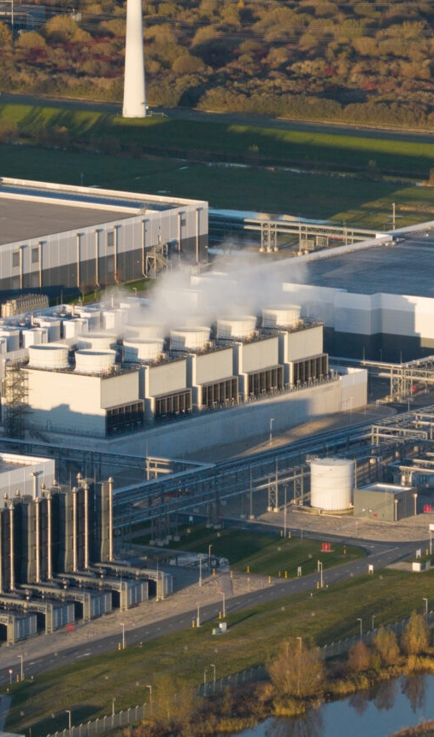
Potable Water & Wastewater
What is the source of water for the data center?
What amount of water will the data center need each day and each year?
  E.g., average day, maximum day, annual total, peak hours, and consumptive use versus water returned as wastewater or discharge
What is the cooling strategy?

Slide 12
Potable Water & Wastewater
What will the water be used for?
  E.g., drinking, industrial, non-potable
How will water usage be reported?
Would infrastructure be able to handle extra wastewater flow and the potential surge in flow to the system?
Have water recycling processes been considered?
Have seasonal or drought conditions been considered to eliminate shortages for residents as well as the data center?

Slide 13
Potable Water & Wastewater
If already engaging with a developer:
Has a third-party regional water study or projection been undertaken that evaluates:
  Drought/low-flow conditions, competing users, utility capacity, and whether the proposed demand would affect service reliability for existing customers (ideally paid for by the developer/applicant)?
Does a utility service agreement include conservation, curtailment, monitoring, reporting, and emergency/drought response provision?

Slide 14
Starting the conversation: Key takeaways
Water
    Talk with the water utility director: What is the system’s total available capacity? Would they be ready to provide information about pipe sizes, available pressures, and capacities? Discuss location of transmission and distribution systems for best placement of a data center.
    Converse with community partners, water personnel, and planners about the source of your water, its capacity limits, your community’s ability to increase capacity, and impacts to existing customers.
    Consider talking with regional water planners/utilities about regional water impacts—what are others in your area considering when it comes to data center development (do you use the same source)?
Notes:
We all live upstream from someone else
Closed Loop vs Evaporative Cooling vs Hybrid Cooling Systems
Public System vs Wells/On-site Wastewater Treatment
Fire Protection (Water Quality in the Pipeline?)
Periodic Flushing Requirements
Everyone is Highly Regulated
Most Utilities Using a “Pay to Play” Business Model
Water Recycling
You Have to Grow A City To Grow A City

Slide 15
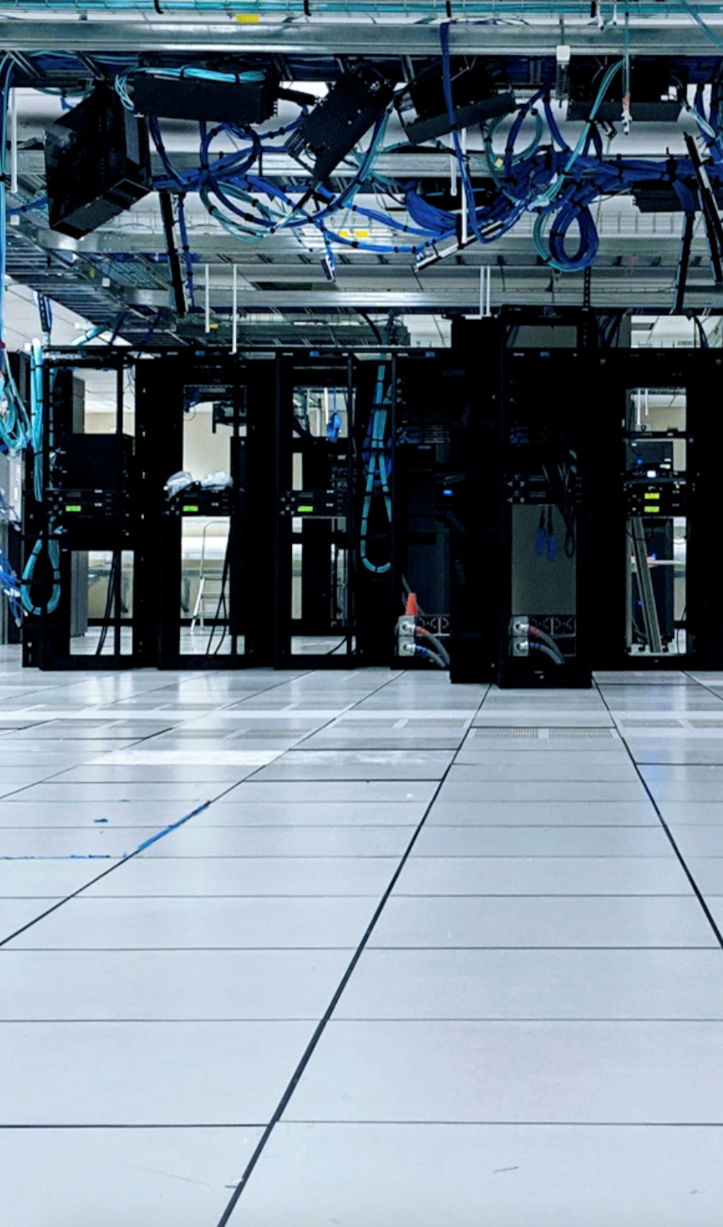
Energy
What are the sources of power available to the data center?
What amount of energy might the data center require, including megawatts at peak load?
How will energy usage be reported?
Will the data center use backup generation, temporary generation, on-site generation, or battery energy storage?

Slide 16
Energy
Has renewable energy procurement been considered?
What ordinances are in place that will oversee air quality emissions and noise associated with power sources?
Will the local distribution utility conduct a rate assessment/impact study?

Slide 17
Energy
If already engaging with a developer:
How many megawatts are needed, as well as transmission, substation, generation, battery or backup infrastructure and is the developer expecting to pay for those upgrades?
  Could upgrades and demand increases affect costs or risks to other customers?
What is the ramp-up schedule?
  E.g., phased by building/campus phase, transmission/substation upgrades

Slide 18
Starting the conversation: Key takeaways
Energy
    Converse with community and regional partners about whether your jurisdiction is willing to host new electricity generation facilities to power data centers.
    Gain an understanding of current and future local energy capacity, in the context of the amount of energy demand associated with different types of data centers.
    Gain an understanding of how ratepayers may be affected by increased demand for energy in your jurisdiction.

Slide 19
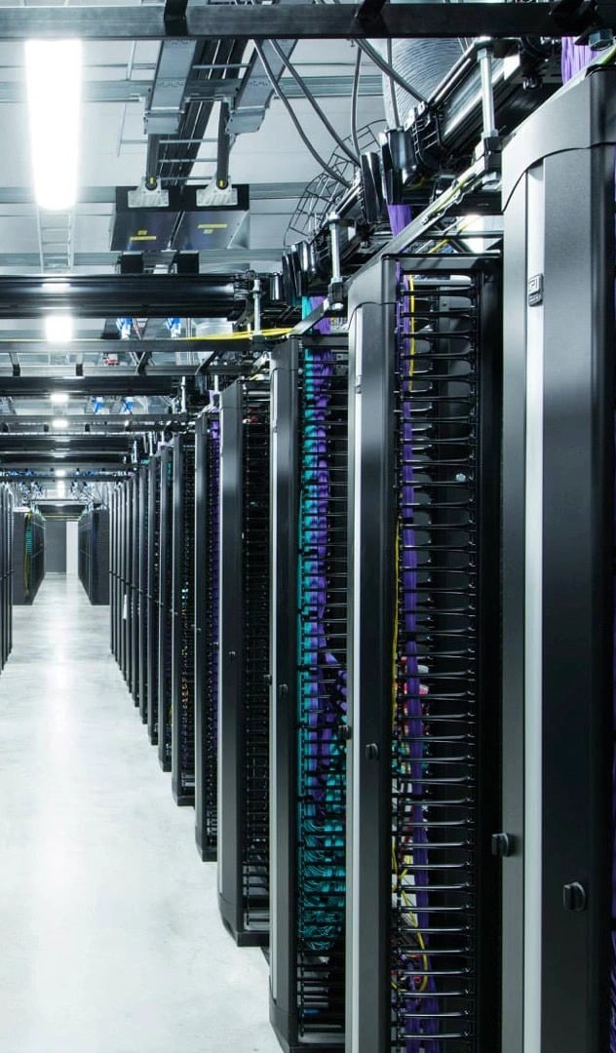
Incentives and Economic Development
Have elected officials conducted net fiscal impact and economic analyses and made the decision to entice a data center to the community?
What state and local tax exemptions or incentives apply?
What taxing entities are affected?
What public costs and benefits are expected?

Slide 20
Incentives and Economic Development
Are there claw backs if investment, jobs, or community benefits do not materialize?
Is there a fund in place for decommissioning the data center at the end of its lifetime?
Have officials considered a statewide or region-wide approach to incentives to improve outcomes for Iowa communities, residents, as well as industry?

Slide 21
Incentives and Economic Development
If already engaging with a developer:
Has a third-party economic impact assessment been undertaken?
  Job creation versus tax abatements and sales tax exemptions, public infrastructure investments, unique revenue streams, and long-term impacts
Does the Development Agreement contain milestones and enforcement clauses, such as assignment/successor language?
  Agreements should remain enforceable if the project is sold, transferred, delayed, partially built, or operated by a new entity
Does the Development Agreement contain provisions tailored to the community?
  Workforce training, broadband expansion, green-infrastructure projects, local infrastructure investment, housing, or betterment funds
Starting the conversation:
key takeaways

Slide 22
Starting the conversation: Key takeaways
Incentives and Economic Development
    Evaluate what are the top priorities for your community (e.g. as a whole, what needs does your community have?) – have a clear understanding of community needs.
    Gather credible information and data about job creation, long term employment, and tax benefits associated with data centers.
    Start a conversation with community and regional partners from across disciplines and jurisdictions to reduce competition and increase coordination.

Slide 23
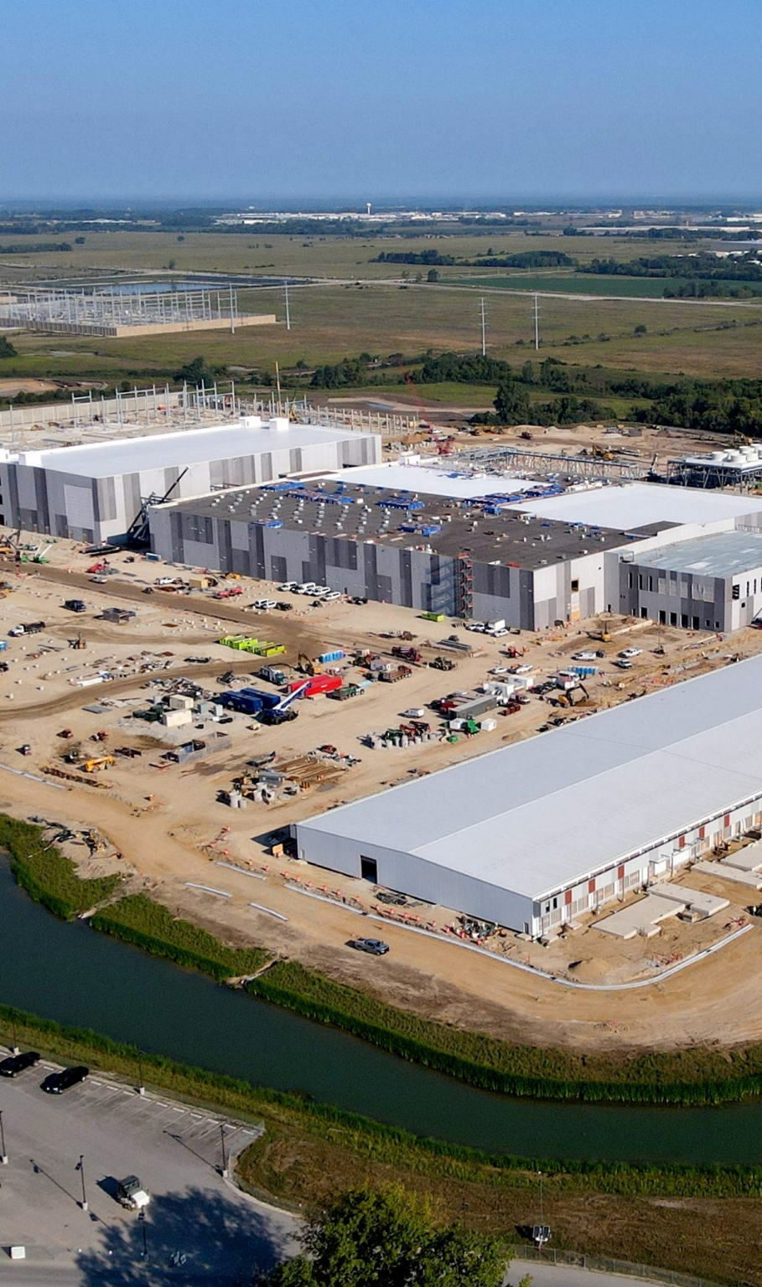
Thinking Ahead: Construction
What will water usage be during construction?
Is there a plan/ordinance and permitting for disposal of construction waste?
Has a road use agreement been discussed or prepared?
  Including pre-construction road condition, designated haul routes, bonding or financial assurance, repair standards, dust control measures, and post-construction restoration responsibilities
What noise impacts are expected during construction?
  E.g., What mitigation measures have been proposed? What levels are expected and when? How will potential or perceived offsite impacts to neighborhoods, schools, livestock, and wildlife be addressed?
What lighting impacts are expected during and post-construction?

Slide 24
Thinking Ahead: Construction
What is the projected length of time for construction; how many phases; how many buildings; and what size?
  E.g., full-buildout assumptions, phase triggers, and whether later phases require additional review if impacts change
Has a plan been discussed or prepared for a construction staging area?
What considerations have been outlined to manage disruption from construction traffic
  E.g., bus routes, routes for construction workers (in community hosting the data center and adjacent areas)
Is there ample housing for construction workers?
Starting the conversation:
key takeaways

Slide 25
Starting the conversation: Key takeaways
Construction
    Gather information from community partners and state officials about waste management during and after construction (e.g. types of waste, permits, reuse, recycling, and diversion of waste from data centers).
    Gather information about potential impacts to adjacent properties and residents during construction.
    Talk with community partners about housing options for potential short-term influx of workers.

Slide 26
“Best Practices”
Look at your local rules before a proposal arrives.
Talk with neighboring communities.
Take a regional approach to water.
Understand whether your community is ready to provide the energy a data center may require.
Be prepared for a range of constituent perspectives.
Build trust through open communication.
Consider whether a temporary moratorium is appropriate.
Decide what happens next before you get to the decision point.
Share what you are hearing.

Slide 27
Audience Questions
For more information about the Iowa Data Center Decision Tool, please contact
Mae McDonough
Program Coordinator
Social Impact Community
Tippie College of Business
mae-mcdonough@uiowa.edu
v
Jennifer Terry
Director
Hubbell Environmental Law Initiative
University of Iowa College of Law
jennifer-terry@uiowa.edu

