Slide 1
HOW DO I FUND THAT??
Maggie Burger, Sr. Vice President
SPEER FINANCIAL, INC.

Slide 2
AGENDA
Introduction
General City Finance Overview
Budget Constraints
Enterprise Funds
Cash Balances

Slide 3
MAGGIE BURGER, SR. VP MBURGER@SPEERFINANCIAL.COM
Senior Vice President, Director and Owner.
Certified Independent Public Municipal Advisor by National Association of Municipal Advisors.
Qualified Municipal Advisor Representative (Series 50) and Qualified Municipal Advisor Principal (Series 54) with the Municipal Securities Rulemaking Board
B.A., Loras College, Finance.
Been a Speer Financial team member for 19 years

Slide 4
GENERAL CITY FINANCE OVERVIEW

Slide 5
HOUSE FILE 718….waiting for the other shoe to drop!!!

Slide 6
DEBT CAPACITY CALCULATION
5% OF 100% Actual Valuation
use military exemption amount
use regular & agricultural
Total principal of GO; LOST Revenue and TIF Revenue debt counts against debt capacity
Total aggregate amount of rebate agreement counts against, if no annual appropriation language is used
Total annually appropriated amount of rebate counts against
100% Valuation
$109,526,378
At 5%
=$5,476,318
Total GO outstanding $4,205,000
No Rebates outstanding
Remaining Debt Capacity
=$1,217,318
Approximately 22.2% Remaining in
Total Debt Capacity
Debt Capacity should be reviewed and calculated annually, based on valuation changes and change in debt outstanding.

Slide 7
GENERAL OBLIGATION BONDS
Full faith and credit; property tax levy used, if no other source of revenue is identified
Lowest cost of issuance of any type of debt issuance
Lowest interest rates in market
Maturity up to 20 years
Essential Corporate Purpose (ECP) – public hearing required
General Corporate Purpose (GCP) Items:
GO Bond Referendum required for approval
Super-majority (60%) needed for referendum passage
Multiple issuances can be done from one referendum
No limitations to debt service levy rate

Slide 8
OTHER CITY FINANCE NOTES
Essential Corporate Purpose (ECP); water, sewer, stormwater, streets, sidewalks, police & fire equipment
General Corporate Purpose (GCP); pool, library, fire station, police station, city hall (renovations to and new builds)
HF718 gives a boost to GCP reverse referendum hearing amounts (annually):
Pop. Under 5,000 - $534,040
Pop. 5,000-75,000 - $934,570
Pop. Over 75,000 - $1,335,100
Debt Service Levy: unlimited levy (pre and post HF718) to pay back general obligation debt service obligations.
General obligation bonds can be abated by other sources of revenue, annually when preparing the budget.
Bond Election Date: Only Regular November election
Budget deadline date: April 30

Slide 9
REVENUE BONDS “Utility, Local Option, Tax Increment Financing (TIF)”
Payable only from “revenues” of the utility system or revenue source
Highest cost of issuance
Highest Interest rates of debt issuance type
Maturity up to 30 years
Public hearing needed for approval
Constraints for issuance:
Debt Service Reserve Fund: (test of 3)
10% of Par; 100% Max Annual Debt; 125% Avg Annual D/S
Additional Bonds Test & Annual Coverage Factor (125%)
Operating/Maintenance Funds required

Slide 10
STATE REVOLVING FUND LOANS (SRF)
SRF offers a Planning & Design (P & D) Loan for 3 yr at 0% interest which can be used to finance the engineering/design cost of the project
SRF current interest rate is 2.84% plus 0.25% annual administration, effective rate of 3.09% for 20yr (up to 30yr loan, with DNR approval will be 1% higher)
SRF loans can be revenue or general obligation based or a combination of both
No debt service reserve fund required
SRF requires Davis Bacon (prevailing wage rate), Buy American Steel and rate ordinances be approved (if rates need to increase for loan) in order to close on the construction loan.
SRF reimburses frequently, so no interim financing should be necessary for SRF loans
Revenue based notes require a 1.10x coverage factor
Operating Revenues minus Operating Expenses = Net Revenues (net revenues must be 110% of total revenue debt payment annually
The Iowa Finance Authority fund the SRF program where City’s can borrow for water and sewer related projects.
This program does not fund growth and the infrastructure needed for growth.
The SRF program funds replacements and repairs to aging infrastructure which is sometime under orders by DNR or EPA.

Slide 11
BUDGET CONSTRAINTS

Slide 12
Property Tax Constraints
Problem
Consideration
General Fund Levy Constraints
Can not keep a city clerk or public works employees
Need to bring more dollars into the City for funding
Roll expenses out for employee benefits, insurance, capital improvement reserve
Share services with another City
Does your City charge a franchise fee, or hotel/motel tax?

Slide 13
HOUSE FILE 718
New general fund & levy limitations
Creates the adjusted city general fund levy (ACGFL)
Limitations for FY 2025-2028
FY 2029 and beyond has the limit of $8.10
Uses a City’s growth in valuation to limit the amount of property tax dollars you can collect in future years.
FY 2024 will be used as the base year for the FY 2025 calculation
The City’s budget forms will auto-calculate these new limits, goal is for the DOM to put out an example calculator ahead of the budget process.
Max Levy Hearing Gone but is replaced with new hearing which must be at a stand-alone meeting
March 5 deadline for report to County (this is 10 days sooner than last year). A statement with proposed division of taxes will be sent to taxpayers before City can hold public hearing and approve the final budget.

Slide 14
OTHER HOUSE FILE 718 NOTES
Commercial property tax exemption (revitalization) requires a minimum assessment agreement be signed by property owner
School District portion of tax levy removed for residential abatement
New homestead exemption for those over 65 in addition to current homestead credit.
Increase in military property tax credit & exemption.
Annual Financial Reports will require more details on debts outstanding
GO Bond Election Dates limited to November only election dates

Slide 15
ENTERPRISE FUNDS AND. SPECIAL REVENUE FUNDS

Slide 16
ENTERPRISE FUNDS
WATER
SANITARY SEWER
STORM WATER
ELECTRIC
GAS
Enterprise Funds account for operations that operate in a manner similar to a business, such as the City utilities. The intent is to establish a rate or charge to sustain the current and long-term operations of the utility.
Rates/Charges should be reviewed annually by City and adjusted so the fund breaks even at the very least.
Planning for future projects, small or large, should be accounted for in annual rate increases.
June 30th fund balance should be no less than 25% of annual revenues or expenses, but could be as high as 100% for most small communities. These reserves are used for un-expected costs or planned future projects.

Slide 17
SPECIAL REVENUE FUNDS
ROAD USE TAX (RUT)
LOCAL OPTION SALES TAX (LOST)
TAX INCREMENT FINANCING (TIF)
EMPLOYEE BENEFITS
Special Revenue Funds contain the proceeds from a specific source and are required by law or regulation to be accounted for separately and used for specific purpose.
City Councils should have policies or plans for the expenditures of these funds.
As these funds grow in annual collections, try to identify new ways to spend or save those funds.

Slide 18
CASH BALANCES

Slide 19
BEST PRACTICES FOR CASH BALANCES
Review and compare cash balances on June 30 of each year
Set fund balance policies for annual carry over amounts or year end amounts
Good Practice
At fiscal year end have between 25-100% of annual revenues as an ending cash balance.
Smaller communities may need closer to 100%, while larger communities maybe closer to the 25-50% range.
Provide Council with monthly/quarterly updates to cash balances
Build up cash balances to be spent on “capital projects/purchases”
Avoid spending cash balances on operational costs
Ladder investments to different sources of money within the City are becoming available at different times of the year.

Slide 20
Comments I hear…
We budgeted for a new skid loader, the old one is still working great, we don’t have to have one this year.
R: Don’t just spend because the budget said so. If you under spend the budget expenses that creates cash balance and cash carries over, so you can add it to your budget next year or budget to use cash next year.
We continue to draw general fund balance down annually to pay operational expenses for running the city.
R: Attempt to lessen operational costs, or look to share certain costs amongst utility funds if those operational costs can be partially attributable
We know we have a new water tower project that is coming in 3 years, but the Council wants to wait to raise water rates until they have an exact cost.
R: Raising rates now, even if just part of what you expect you will need, will generate more cash balance, which is not being used yet. At the time of the project if you are $100,000 ahead in cash balance that is less money you need to borrow and repay

Slide 21
QUESTIONS?
Maggie Burger:
319.291.2077 OFFICE
563.920.1145 MOBILE mburger@speerfinancial.com

Slide 22
CAPITAL IMPROVEMENT PLANNING (CIP)

Slide 24
PLAN PLAN PLAN PLAN PLAN
PLAN
Capital Improvement Planning can be one of the best tools a City can use when confronting shrinking budgets and revenues.

Slide 25
Simple Capital Improvement Planning (CIP)
Hold meetings with Council, Departments and Citizens
Make List of three categories
Immediate Needs
Future Needs
Wants/Wishes
Work through the lists
Now
Future
Set a plan for 3-5 years
Identify the funding sources, which might slim down the wants/wishes lists
This should outline cash and borrowing needs
This plan has to be reviewed annually, adjusted for projects completed, moved to a different year or added to the plan
FOLLOW THE PLAN…to the best of your ability
There are private companies, COGs and local Colleges/Universities that can assist you with capital improvement plans

Slide 26
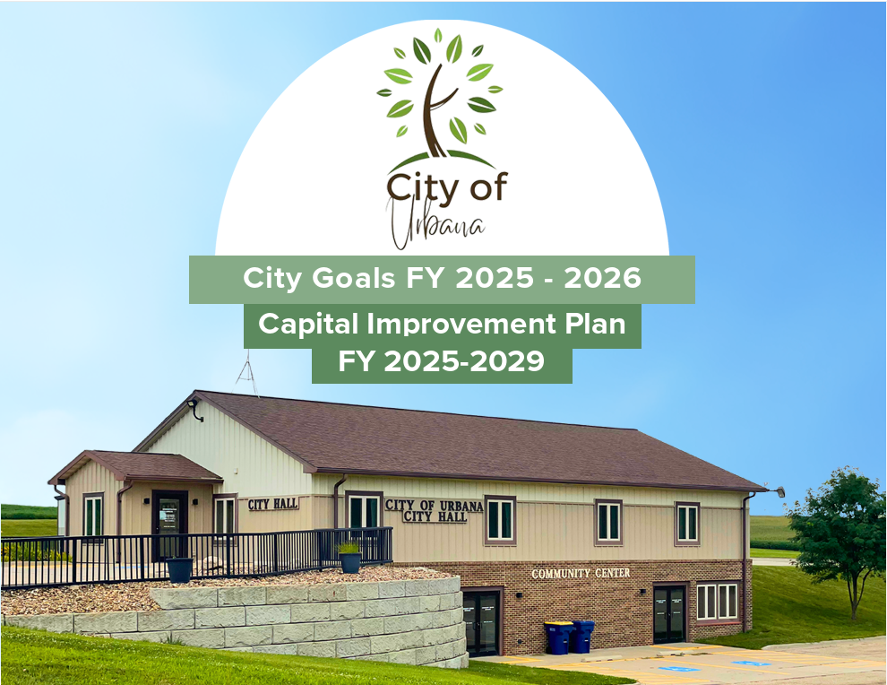
Urbana/ECICOG Case Study
https://acrobat.adobe.com/id/urn:aaid:sc:US:8996954a-0042-44d8-b138-1927824a77d9?viewer%21megaVerb=group-discover

Slide 27
Urbana/ECICOG Case Study
Project Introduction
(Council Meeting)
Information Gathering
(Survey)
Council Prioritization
(Survey)
CIP and Goal Development
(Staff/Council Work Session)
CIP Review and Approval
(Council Meeting)
Goal Refinement
(Council Work Session)

