Slide 1
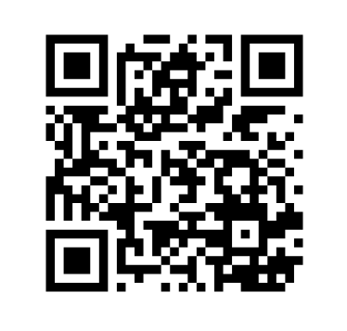
Please register.
Link:
www.kirkwood.edu/ctregistration
Notes:
(0 min.)
QR Code to KCT’s registration form.

Slide 2
Growth Mindset: Navigating Turbulent Times with Less Stress
Brenda Meeker
Your Partner in Progress
Copyright 2025 Elevate Consulting, LLC
Notes:
(1 min.)
You’ve had a day of learning and focus on topics that can support your work.
I hope you’ve also had a chance to connect with each other. If not yet, I hear there are some small group opportunities coming, with wine.
I hope it’s been a moment to disconnect from the daily routine so that you walk away recharged, equipped with some new knowledge, tools, and ideas – so that you can navigate the work that lies ahead of you.
Source:
“Mindset Word Written In Wooden Cube, business concept” by Eugene Zvonkov from Getty Images. Canva.com. Accessed 8 May 2025.

Slide 3
“You came in one way.
You don’t have to leave the same.”
Notes:
(3 min.)
Today, you walked in one way.
Good news, you don’t have to leave the same.
You can take something – maybe many things – and use it to make your work and community better.
And guess what? That is true each day!
Each day is brand new, and it’s a chance to be impactful and impacted.
Let’s take 1 minute – share with the person next to you one way you will be leaving different today.
What’s one thing that has impacted you or will help you make an impact?
One minute – Go!
[Ask for a couple of people to share]
I’m here to add some ideas that you can consider to take away and apply to work.
The best part: It applies to life in general.
Source:
from Getty Images Signature. Canva.com. Accessed 9 Sept. 2024.

Slide 4
Today’s Plan
Explore growth and positive mindsets
Identify strategies and tips to choose our mindset and manage stress as we work toward positive outcomes
Notes:
(0 min. – Time with previous slides)
Here is the plan for our time together:
[Read slide]
Today, we are going to:
Talk with each other
ADD MORE
Source:
“Plan 3d colorful buzzword” by donskarpo from Getty Images. Canva.com. Accessed 16 Oct. 2023.

Slide 5
Change Happens…
Sometimes:
It happens to you.
You start it.
You’re the messenger.
Notes:
(1 min.)
Can we agree that change happens?
[Pause]
Yes, change happens. – We know that!
[Click]
When we think about change in an organization, sometimes:
It happens to you.
You start it.
You’re the messenger.
Sources:
“Changing business management concept” by tadamichi from Getty Images. Canva.com. Accessed 11 Dec. 2024.

Slide 6
Change May Feel…
Constant
Chaotic
Complicated
Handout p. 1
It brings uncertainty.
Notes:
(2 min.)
Change may feel:
Constant
Chaotic
Complicated
And pick a different adjective – but can you keep the alliteration? ☺
I’ve got another one for you…[Click]
Change of any kind often brings with is uncertainty.
How do we get to the end of what looks like a jumbled mess.
Where are we in the midst of this?
How do I not get tangled up in chaos – or in the feelings – to a point where it impacts my work and life in a less than positive way.
Change and uncertainty can come with certain feelings.
At the local government level, you may be feeling a lot of “It happens to you.” and “We don’t know what this means.”
I know that it’s a tough time for a lot of people, and you may feel that way.
Our time together this afternoon is meant to help us think about how to navigate where we are – any time and when things feel a bit bumpy, like they may right now.
Sources:
“Chaos” by ClarkandCompany from Getty Images Signature. Canva.com. Accessed 12 Dec. 2024.

Slide 7
Mindset
Notes:
(0 min.)
Part of our navigational system is our mindset.
Source:

Slide 8
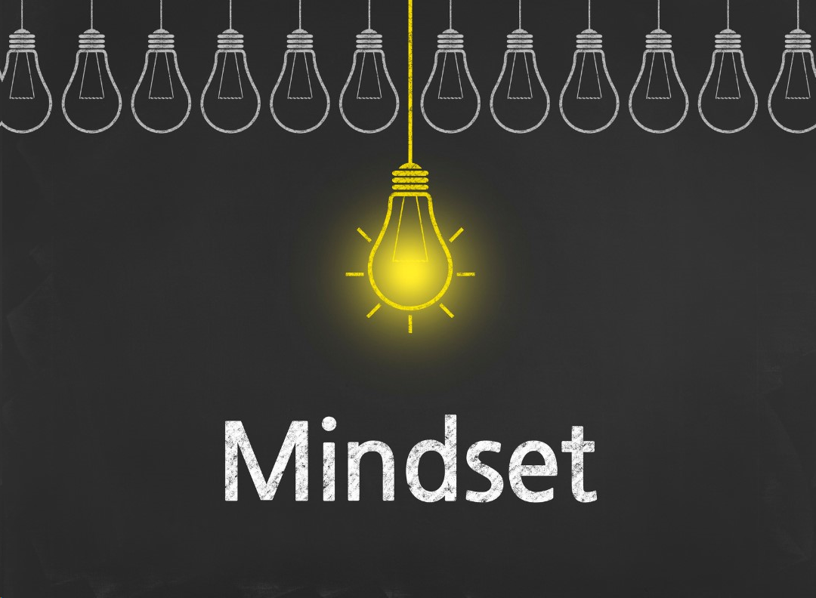
What is Mindset?
Mindset:
Mental attitude
Beliefs that inform how we view the world
Handout p. 1
Notes:
(2 min.)
I want to propose to you that your mindset can make a big difference in navigating your days.
What is a mindset?
Mental attitude
Beliefs that inform how we view the world
And therefore how we respond
This topic of mindset starts with us.
It’s about more than a specific job.
Mindset affects how we approach work overall and life, and the choices we make based on what we believe.
Because of that, it affects how we show up with other people and for ourselves – which does have an impact on those we serve.
There are a variety of mindsets we can have. Maybe you’ve heard people say, “They need to change their mindset.”
Our mindset about anything matters – [E.g. our mindset about working as a team matters.]
If we think people don’t want to work together toward a solution, will we have the conversation with them?
Why should I invest the effort?
Today, we are going to talk about a specific mindset: [Click]
Source:
“Mindset – Business Chalkboard Background” by hanibaram from Getty Images Signature. Canva.com. Accessed 25 Nov. 2023.

Slide 9
Growth Mindset
The belief that one’s qualities can be cultivated and changed through applicable strategies and effort
Handout p. 1
Notes:
(1 min.)
A Growth Mindset.
Growth Mindset: The belief that one’s qualities can be cultivated and changed through applicable strategies and effort.
Just like it takes strategy, a plan, and effort to build the word “growth” out of blocks, we can utilize those to grow and change in our own lives.
If there is a growth mindset, there must be another kind of mindset that contrasts with it: A Fixed Mindset.
Source:
Dweck, Carol. Mindset. New York, Ballantine Books, 2016.
Wooll, Maggie. “A growth mindset is a must-have – these 13 tips will grow yours.” BetterUp, 26 July 2021, www.betterup.com/blog/growth-mindset.
“Growth” by kemalbas from Getty Images Signature. Canva.com. Accessed 7 May 2025.

Slide 10
Fixed and Growth Mindsets
Fixed Mindset: The belief that a person’s qualities are set and cannot change | Growth Mindset: The belief that one’s qualities can be cultivated and changed through applicable strategies and effort
Need to prove myself repeatedly | Can learn and change
Believes they know all they can | Desires to learn
Failure means lacking intelligence/talent | Failure is a part of learning and growing
Choose comfort zone/the “safe” route | Choose to push/stretch myself
Effort means I lack something | Effort is part of growth
Handout p. 1
Notes:
(3 min.)
Fixed Mindset: The belief that a person’s qualities are set and cannot change
These two mindsets impact how we talk to ourselves – and others, and what we are willing to do.
Let’s look at the differences between the two mindsets – what they can look like or sound like:
Fixed: If I have all the intelligence and talent I will ever have, I have to prove myself over and over.
I need to show you that I’m smart and talented – because it’s all I have.
Growth: I can learn new things and change.
I don’t have to prove myself. I may not know something yet.
Fixed: Believes they know all they can know
And they will tell you what they know – because they need to prove they’re smart
Growth: Desires to learn
They can know more; they can change their thinking.
What could this sound like?
[Wait for responses]
“I know how to do that.” “I already know that.” – May or may not be true.
Vs.
“I think I know, but let’s go over that.” “I’ve never done that. Can you teach me?”
Fixed: If I fail, I lack intelligence and talent.
I won’t try. I can’t do it; never will. Move on to save face, as much as possible.
Sounds like, “I’m no good.”
When comparison creeps in, it sounds like, “They are so talented. They are better than me.”
Growth: Failure is part of the learning and growth process.
I will pick myself up, dust myself off, and keep moving forward.
Fixed: Choose comfort/the “safe” route.
I will avoid challenges so that I can continue to prove myself.
If it’s too challenging, I probably can’t learn it anyways.
Growth: I choose to push myself.
I will take on the challenge because I believe I can grow and do better.
Fixed: Putting forth effort means I lack something – intelligence or a skill or ability.
A fixed mindset says I already have that, so it should be effortless.
Growth: Effort is a part of the growth process.
If I’m building knowledge or skill, it will take work.
Maybe some of this sounds familiar to you.
Maybe you can see some of this in yourself – past or present.
Maybe you see something you want to believe in the future – and that future can start now.
Sources:
Dweck, Carol. Mindset. New York, Ballantine Books, 2016.
Wooll, Maggie. “A growth mindset is a must-have – these 13 tips will grow yours.” BetterUp, 26 July 2021, www.betterup.com/blog/growth-mindset.

Slide 11
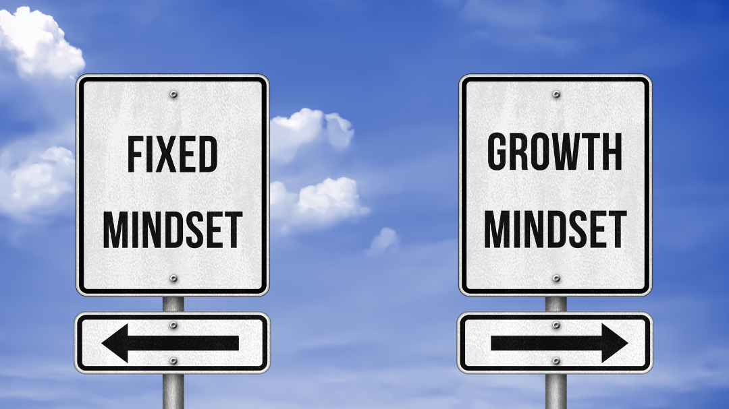
Which mindset do you have?
YES!
Notes:
(1 min.)
Think to yourself – Based on this, which mindset do you have – Growth or Fixed?
[Pause]
Yes. The answer is yes!
We all have both mindsets.
It’s a misconception that a person is fully one or fully the other.
It’s on a spectrum and can change based on the situation or the day and circumstances we are in, which may be how we are feeling and handling things.
For example…
Sources:
“Fixed Mindset vs. Growth Mindset” from gguy44 from Getty Images. Canva.com. Accessed 7 May 2025.

Slide 12
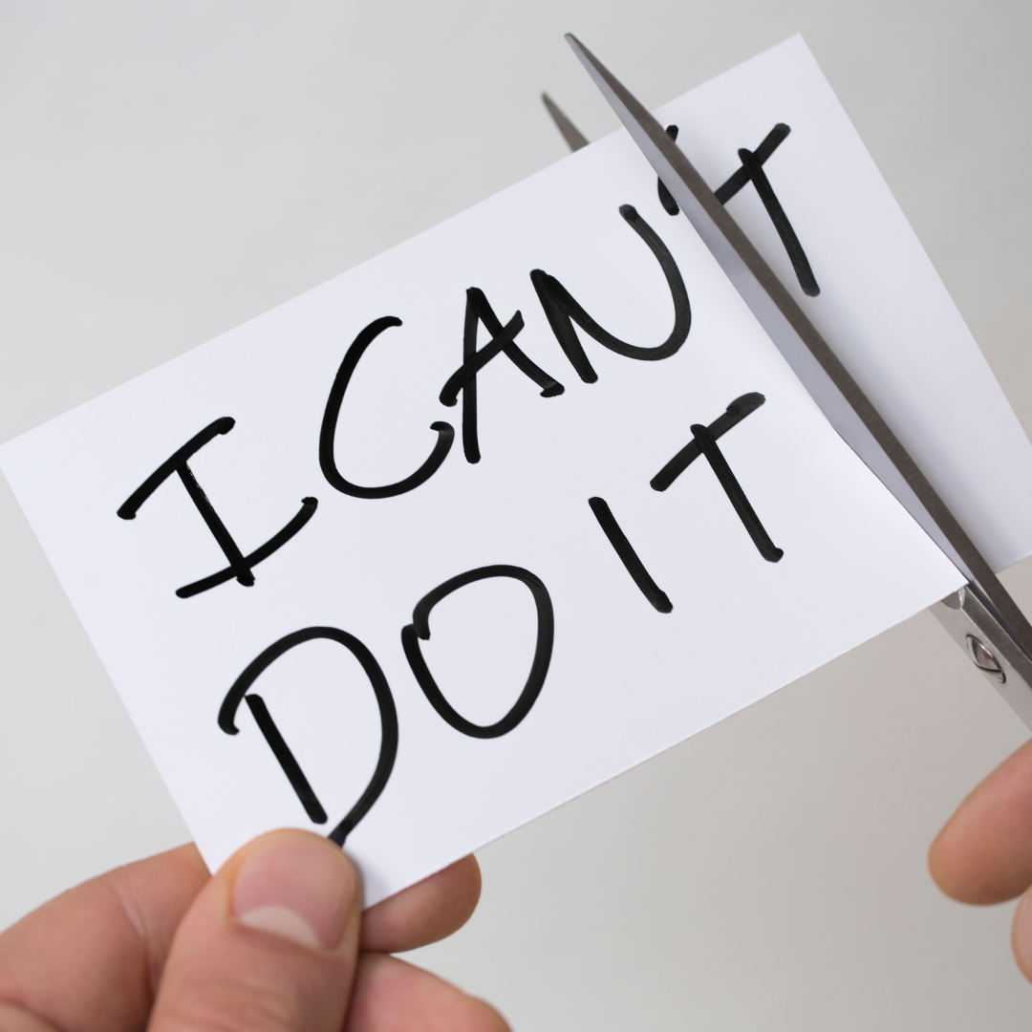
In Recreation
Handout p. 1
Notes:
(1 min.)
[Tell story about riding a bike]
Sources:
“I Can’t Do It” by idealstock from Getty Images Signature. Canva.com. Accessed 7 May 2025.

Slide 13
Perfection and Effort
In all forms of education…
Handout p. 1
Notes:
(1 min.)
In all forms of education, I aimed for perfection or really close to it. I took any constructive feedback really hard, like it was a failure.
I had to prove myself, to show how smart I was. – I didn’t think about that consciously, but it was evident in my actions.
I was demonstrating a fixed mindset.
At the same time, though, I put in a lot of work studying and trying to learn.
I couldn’t sit in class, know the material, and ace the test.
I had to work at it.
And I believed I should work at it – that learning should take effort and that’s good.
That’s the growth mindset.
Sources:
“Perfect Final Exam Score” by zimmytws’s Images. Canva.com. Accessed 7 May 2025.
“Person Studying And Writing Notes on Paper” by Kaboompics.com from Pexels. Canva.com. Accessed 7 May 2025.

Slide 14
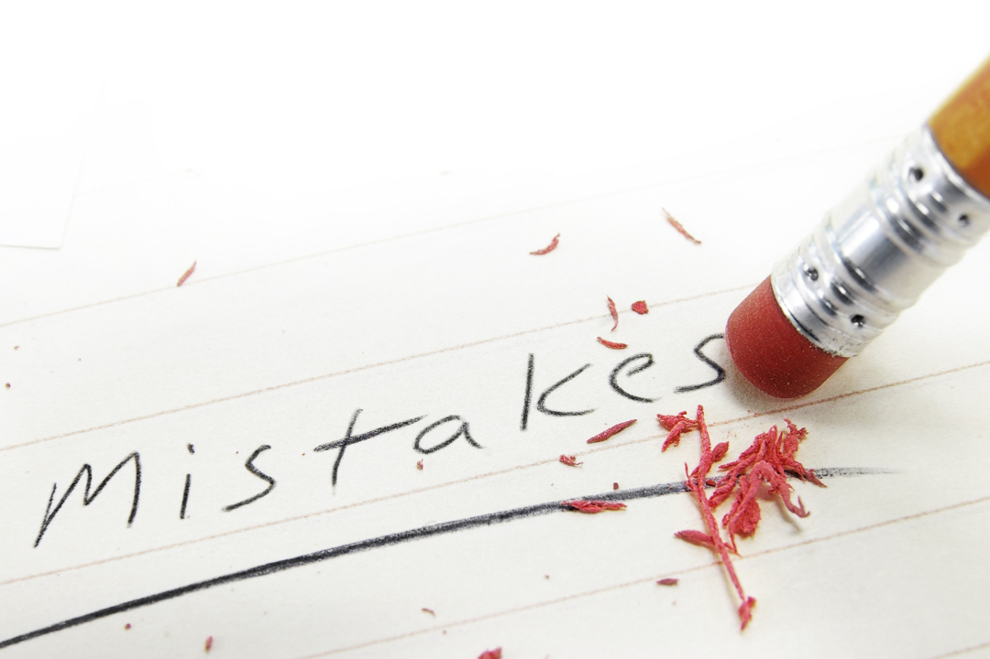
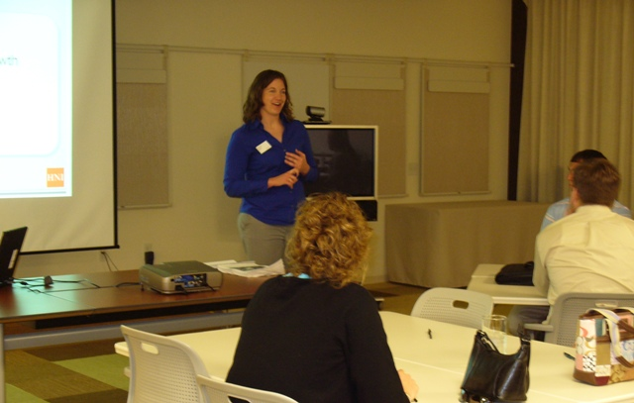
Only Great Work Allowed and Learning
Handout p. 1
Notes:
(1 min.)
For many years at work, I acted like I was afraid of mistakes.
I didn’t want to not know something or not be great at the work.
I wanted to be the best, and sometimes in a competitive way.
I was demonstrating a fixed mindset.
While I also was actively engaged in offering learning opportunities.
Believing that I and others can grow in knowledge and skills.
There was consistently a hunger to learn.
With learning, comes a learning curve – which means we aren’t great right away.
There was a growth mindset.
Sources:
“Fixing a mistake” by zimmytws from Getty Images. Canva.com. Accessed 7 May 2025.

Slide 15
Growth is good!
Handout p. 10
Notes:
(1 min.)
A growth mindset is helpful.
We see opportunity.
We see how we can contribute and adjust and adapt.
We don’t have to stay the same.
And we know that failure or obstacles are not final.
Source:
“Growth” by yaruta from Getty Images Pro. Canva.com. Accessed 7 May 2025.

Slide 16
Let’s Be Clear
Growth mindset:
Is not only about effort
Does not always yield positive outcomes
Is not the same as a positive mindset
Handout p. 2
Notes:
(1 min.)
Let’s be clear – because there are misconceptions about growth mindset.
A Growth Mindset:
Is not only about effort.
It’s important to try and work hard.
To show persistence and learn from change and challenges.
But our efforts must lead somewhere – to our goal, to the results we need
Does not always yield positive outcomes – at least not right away.
Sometimes we work and try really hard, and things don’t go as planned.
Sometimes they don’t work at all.
Yet we need to try new things, take some wise risks, and do the work to solve problems and grow our communities.
[Tell softball change-up story]
Is not the same as a positive mindset
[Click]
Source:
Dweck, Carol. “What Having a “Growth Mindset” Actually Means.” Harvard Business Review, 13 Jan. 2016, https://hbr.org/2016/01/what-having-a-growth-mindset-actually-means.
“Do Not Park Sign” by claudiodivizia. Canva.com. Accessed 8 May 2025.

Slide 17
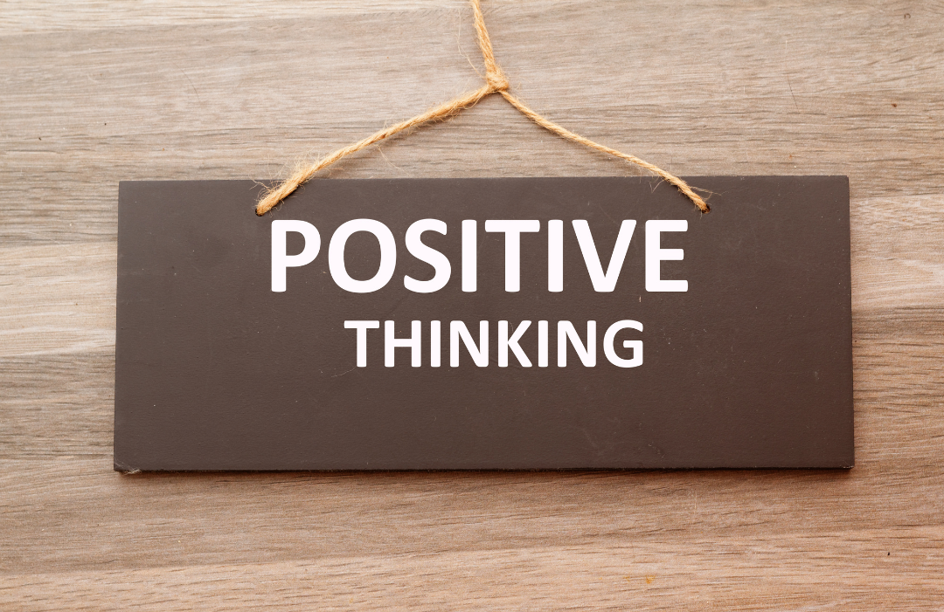
Positive Mindset
“a tendency toward optimistic thinking”
Handout p. 2
Notes:
(1 min.)
A positive mindset is “a tendency toward optimistic thinking.”
It’s not dismissive to reality, but it doesn’t land on “it’s all bad.”
With this mindset, we acknowledge difficulties but don’t live there.
Growth mindset is about the ability to change and learn.
Positive mindset would include staying optimistic when the process is hard or others share a different belief than that ability.
Source:
Perry, Elizabeth. “Try a positive mindset for success and well-being.” BetterUp, 23 Feb. 2024, www.betterup.com/blog/positive-mindset.
“Word POSITIVE THINKING written on chalkboard” by RaihanaAsral from Getty Images. Canva.com. Accessed 8 May 2025.

Slide 18
Your Mindset Moments
Discuss:
In what moments / situations does your mindset matter?
When has (or could) your mindset (growth or positive) had a positive impact on you, others, or a situation?
Notes:
(5 min.)
Let’s think about the impact of your mindset.
In a moment, go back to the person next to you and discuss: [read slide]
Let’s take a few minutes for that discussion.
[Give 3-4 min.]
[Ask if anyone would like to share]
[Give my example – We can all have success. It’s not a competition about who can contribute more or better. We need that to accomplish what our organizations and communities need.]
Source:
Perry, Elizabeth. “Try a positive mindset for success and well-being.” BetterUp, 23 Feb. 2024, www.betterup.com/blog/positive-mindset.
“Historical Moment” by in-future from Getty Images Signature. Canva.com. Accessed 8 May 2025.

Slide 19
Stress
Notes:
(0 min.)
Part of our conversation today needs to be about stress. In the title we referenced “less stress.”
This implies we have stress.
Anyone ever stressed at work or in life?
Source:

Slide 20
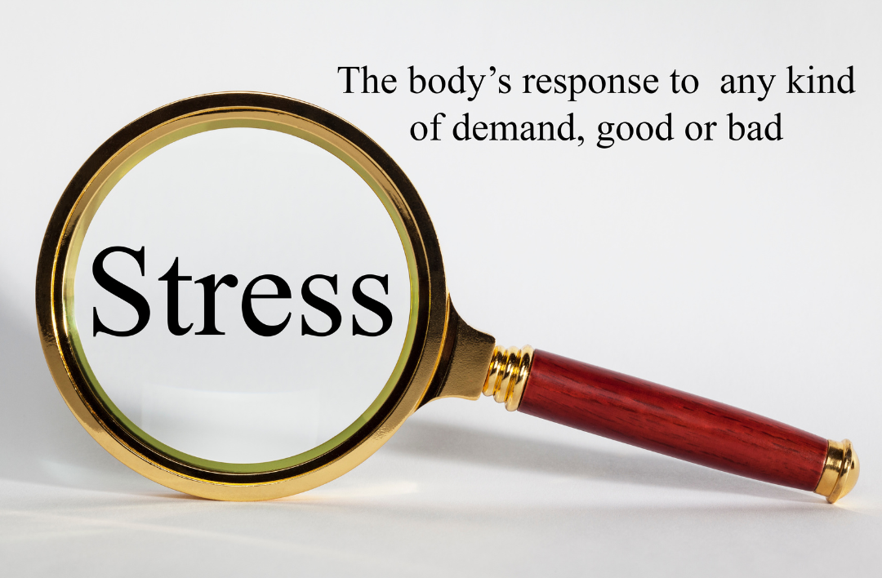
Stress
Definition:
“the natural reaction your body has when changes or challenges occur”
What do you believe about stress?
Notes:
(2 min.)
Stress: “the natural reaction your body has when changes or challenges occur”
Let me ask you this: What do you believe about stress?
[Wait for responses] – Possible answers: unavoidable, don’t like it, harmful, makes us feel things we would prefer not to.
“When changes or challenges occur.”
We already agreed that change happens.
And we work with challenges consistently.
Stress.
Stress can be caused by positive or negative stressors.
Going on vacation – it’s a change and getting there could be a challenge, but it’s a good one!
Trying to hit a deadline - when time is running out and there’s a lot at stake, that’s a negative stressor
Stress is going to happen. We will have responses to it. And we need to manage it so that it does not have negative impacts on us – at work or on our life and health.
Source:
“Stress.” Cleveland Clinic, https://my.clevelandclinic.org/health/diseases/11874-stress. Accessed 7 May 2025.
“Stress Concept” by travelinglight from Getty Images. Canva.com. Accessed 8 May 2025.

Slide 21
Stress and Mindset
How could mindset affect stress?
Notes:
(2 min.)
What if our mindset could play a role?
How could mindset affect stress?
[Wait for responses]
Fixed mindset:
There’s a weight in having to prove yourself – adding unnecessary pressure
Maybe we are being careful to guard ourselves so that we stay in the safe zone – trying to avoid challenge
Maybe our thought processes are adding stress – If we believe effort means I lack something and I catch myself having to work so hard at something, there must be something wrong with me. And then we fixate on that.
Growth mindset:
We can be more willing to accept change as an opportunity – So we see the challenge, we accept it, and we move forward in it.
And if we are leaning in and choosing the challenge of learning and getting better – at whatever it may be – it can be a positive stressor.
Positive mindset:
Failure is less stressful.
Research has shown that a positive mindset has positive effects on mental health
Plus it impacts physical health through awareness and choices in building healthy habits.
Source:
Perry, Elizabeth. “Try a positive mindset for success and well-being.” BetterUp, 23 Feb. 2024, www.betterup.com/blog/positive-mindset.
Primeau, Mia. “Your powerful, changeable mindset.” Standford Report, 15 Sept. 2021, https://news.stanford.edu/stories/2021/09/mindsets-clearing-lens-life.
“Growth” by kemalbas from Getty Images Signature. Canva.com. Accessed 7 May 2025.

Slide 22
How to Move Forward
Notes:
(0 min.)
Mindsets and stress.
How do we move forward so that we can feel better in our work and as we strive for positive outcomes in our work and communities?
Source:

Slide 23
Stress Management
Take care of yourself
Eat right
Physical activity
Relax
Sleep
Focus on the good and gratefulness
Change your mindset
Handout p. 2
Notes:
(1 min.)
Topic:
It can be challenging taking care of yourself.
You have a lot to do at work and in life.
Maybe you work a lot of hours.
And all jobs can get stressful.
Recharge – Exercise, get enough sleep, make time for the activities you enjoy – all so that you can feel refreshed.
A well-rested and rejuvinated mind and body will help with stress management and make it easier for you to utilize the skills and strategies put into place to be better with self-management.
Source:
Perry, Elizabeth. “Try a positive mindset for success and well-being.” BetterUp, 23 Feb. 2024, www.betterup.com/blog/positive-mindset.
“Stress.” Cleveland Clinic, https://my.clevelandclinic.org/health/diseases/11874-stress. Accessed 7 May 2025.
“Black serious man breathing fresh air in a park” by Pheelings Media from Getty Images. Canva.com. Accessed 8 May 2025.

Slide 24
Developing a Growth Mindset
Focus on your thinking/language
Reflect & self-examine
Start!
Reinforce that you can by doing
Make progress, get better
Be realistic
Honest assessment
Focus on learning
For self
From others
Because of change and challenges
Avoid blaming, comparison
Use “yet” and “I can”
Reflect
Plan
Act
Handout p. 2
Notes:
(3 min.)
I want to offer some ways we can develop and optimize our mindset so that we can set ourselves up for success and have a positive impact.
First, focus on your thinking/language.
Remember, fixed and growth mindset is on a spectrum. We can move between the two on any given day or based on the topic. And changing our mindset doesn’t happen overnight.
We need to be careful what we think to ourselves and how we speak – to ourselves and others.
What does this mean?
Avoid blaming – put our ego aside, own our mistakes, learn from them.
Avoid comparing ourselves to others – Others’ success or recognition does not mean we are less than or can’t be great, too. – That’s a fixed mindset talking.
We are less defensive when receive feedback. Listen and learn.
It also means we use different language, like:
“Yet” – I don’t know how to do that yet.
“I can” – I can learn that. I can do my best, or better; let me try again.
This idea ties back to rewiring our brain. We need to say and do different things over and over so that they can become our go-to response.
Can you encourage people to think differently. If they say, “That won’t work.” Could you say, “That hasn’t worked before, so what could we do differently to try again?”
[Click]
Next, we reflect and self-examine.
Take an honest look at what happened, and in this case, what we believe about what happened.
Did you revert back to fixed mindset language? What story did you tell yourself?
Maybe you were working with someone and thought to yourself, “They will never change.” And that led to how much effort you put into the conversation or relationship.
Be honest with yourself about what happened and make a plan for what you will do differently.
Maybe that plan is to take deep breath and pause when you get frustrated, and tell yourself, “Listen to what they have to say; what can I learn?” And then figure out how to approach the situation differently.
You may also have a realization as you reflect that you had the thinking and made the choices that you want to make in a given situation. Yay! Celebrate that.
Then your plan is to do it again!
This plan helps you focus on learning and growing.
For ourselves
From others
Because of change and challenges – view them as opportunities
[Click]
Finally, we need to Start – we need to act.
Doing reinforces our thinking. – If I believe I can learn, I’m going to go do that.
The process matters – Trust the process!
The process will help us make progress.
I do want to add that this is where we want to be realistic.
I’m not going to go create a website from scratch tomorrow – I don’t know how to code and that would take time.
But I could start learning Java or some computer coding that would help me.
And there are some things that we may not be capable of achieving. Growth Mindset does not guarantee that we will be successful at all things.
It does set us up to be able to try new things and continue to learn and grow.
We can’t say we’ve “arrived.”
Sources:
Clear, James. “How Your Beliefs Can Sabotage Your Behavior.” https://jamesclear.com/fixed-mindset-vs-growth-mindset.
Whitener, Svetlana. “The Value of a Growth Mindset, and How to Develop One.” Forbes, 6 Jan. 2021, www.forbes.com/sites/forbescoachescouncil/2021/01/06/the-value-of-a-growth-mindset-and-how-to-develop-one/?sh=47b058934d2f.
Wooll, Maggie. “A growth mindset is a must-have – these 13 tips will grow yours.” BetterUp, 26 July 2021, www.betterup.com/blog/growth-mindset.

Slide 25
Fostering a Positive Mindset
Control Your Self-talk
Be Helpful
Be Grateful
Handout p. 2
Notes:
(2 min.)
Control your self-talk – The words we say to ourselves matter.
Who has a voice in their head that likes to tell them lies? Or a voice that’s a real bummer to listen to?
[Wait for response]
We all do.
A study from the National Science Foundation that 80% of our thoughts are negative.
It seems to be part of how we are wired. Even if we lean positive, we negativity built in on some level.
Like our Fight or Flight response, it can be about survival.
We know we have the negative thoughts and feelings.
Are we reinforcing them?
Or are we saying, “That is a false thought.” And replace it with something that is true.
It’s like when we say, “I will never learn that. Or I’ll never be good at that.”
We replace it with, “I am still learning. I will get better at this with more time and proper practice.”
Control your self-talk
What thoughts will you keep?
What thoughts are helpful?
What thoughts will be helpful instead?
Be Helpful
Another topic to journal is what you are grateful for.
Being grateful puts us in a positive state of mind.
None of this means we ignore our challenges.
But intentionally thinking about good things and what we are grateful for can alter our mood for the better, which can change how we show up and how we feel.
Sources:
Perry, Elizabeth. “Try a positive mindset for success and well-being.” BetterUp, 23 Feb. 2024, www.betterup.com/blog/positive-mindset.
“Help Icon” by OLEKSSANDR YEROMIN. Canva.com. Accessed 8 May 2025.
“Positive self-talk” by Annie Masha from Masha. Canva.com. Accessed 11 Sept. 2024.
“Thinking Icon” by creativepriyanka. Canva.com. Accessed 26 May 2023.

Slide 26
Fostering a Positive Mindset
Be Well – Recharge
Assume Positive Intent
Handout p. 2
Notes:
(1 min.)
Be well – Recharge
We’ve heard this before.
Assume positive intent
How many of you do a lot of communicating by email or text or typed or written note?
[Wait for raised hands]
A lot of us do!
It’s great to get information in writing, and have info written so that you can look back at it.
But do you ever read an email or text and put tone into that may not actually be there?
We think, “Oh, Brenda wrote that. She’s being demanding and telling me what to do.”
Or, “why does she have to be rude?”
Or, “why are they mad at me?”
When all I tried to do what get a message to you quickly – short and sweet.
We are making some assumptions, because we don’t know for sure.
Or maybe you are in a meeting or having a conversation, and someone says something that we interpret a certain way.
Do we hang onto that and believe our assumption is 100% right and that person shouldn’t have said that?
Or do we give them any benefit of the doubt.
I believe I’m not the only one in the room today who has moments like these.
And when we do, let’s Assume Positive Intent.
Give them the benefit of the doubt.
Assume they said that or emailed it or acted that way with the best of intentions.
And then we can be curious and learn more if we need to.
Hey, Brenda, did you mean this?
Oh, no, that’s not what I meant. I meant ______.
When we start from a place of assuming the best, we are able to maintain positive thoughts.
And it keeps us from unnecessarily judging, when in fact, we may be wrong.
Sources:
Perry, Elizabeth. “Try a positive mindset for success and well-being.” BetterUp, 23 Feb. 2024, www.betterup.com/blog/positive-mindset.
Wakeman, Cy. “Primed for Change.” Association for Talent Development, 2 March 2020, www.td.org/content/td-magazine/primed-for-change.
“Flat Battery Charge Icon” by Oleksa. Canva.com. Accessed 8 May 2025.

Slide 27
What else would you add to your list of strategies / tips?
Identify the ones that resonate with you most.
Handout p. 2
Notes:
(1 min.)
Let’s pause here for a moment.
Think about what strategies and tips stand out related to getting to less stress and a mindset that guides us forward positively.
What else would you add to your list that you already do?
Source:
Dweck, Carol. “What Having a “Growth Mindset” Actually Means.” Harvard Business Review, 13 Jan. 2016, https://hbr.org/2016/01/what-having-a-growth-mindset-actually-means.
“Pause web icon” by megainarmy from Getty Images. Canva.com. Accessed 8 May 2025.

Slide 28
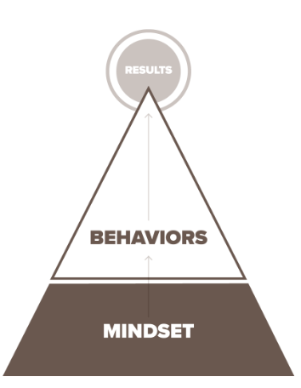
Mindset – Behavior – Results
Start
with
Mindset
Source: Arbinger Institute. https://arbinger.com/difference.html
Notes:
(1 min.)
I want us to recognize that “mindset drives behavior.” This illustration from The Arbinger Institute shows mindset as the foundation that leads to behaviors that lead to results.
We can focus on and teach behaviors to get the results we are looking for, and often, that’s what we do.
We also need to focus on our mindset,
When our mindset changes, our behaviors will change to match it.
We can still teach the behaviors we need, and many of them will be more natural because we have the mindset that matches it.
Arbinger contends that when our mindset is different, we can choose behaviors and solutions on our own that we may never have seen before.
How we lead ourselves and others starts in our mind.
Sources:
The Arbinger Institute. The Outward Mindset. Oakland, Berrett-Koehler Publishers, Inc., 2019.
Image from Arbinger Institute. https://arbinger.com/difference.html. Accessed 17 March 2023.

Slide 29
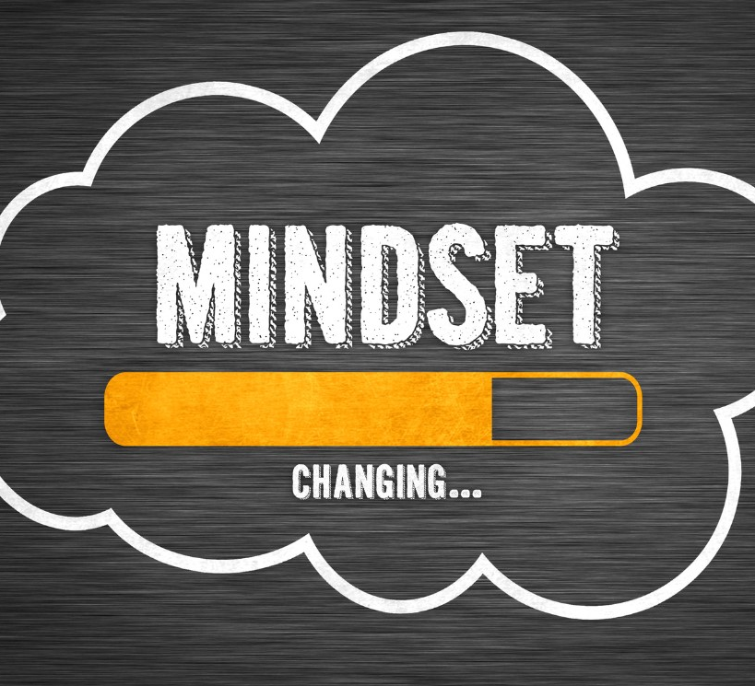
Choose Your Mindset
Handout p. 2
Notes:
(2 min.)
You get to choose your mindset.
Even when:
Everything around you seems hard.
Everyone around seems negative or stuck in their ways.
You know: “We’ve always done it this way.” or “Everything is bad. It’s ruined!”
We still have choice.
So how will you work on yours?
How will you see opportunities in the changes and challenges?
What will you say to try to bring others along?
How will you choose positivity when it feels like everything around you is negative?
You have some tools and ideas, and there are certainly others.
So, what will you do?
How will you apply this?
Take a moment and think about that. I encourage jotting down a note as a reminder of what you want to do.
Source:
“Change your mindset” by gguy44 from Getty Images. Canva.com. Accessed 25 Nov. 2023.

Slide 30
“You came in one way.
You don’t have to leave the same.”
Notes:
(1 min.)
“You came in one way; you don’t have to leave the same.”
That can also be part of your mindset – applied to growth or positivity.
And I hope it is.
Thank you for your time today.
Source:
from Getty Images Signature. Canva.com. Accessed 9 Sept. 2024.

