Slide 1
Before Construction Starts: Planning & Considerations

Slide 2
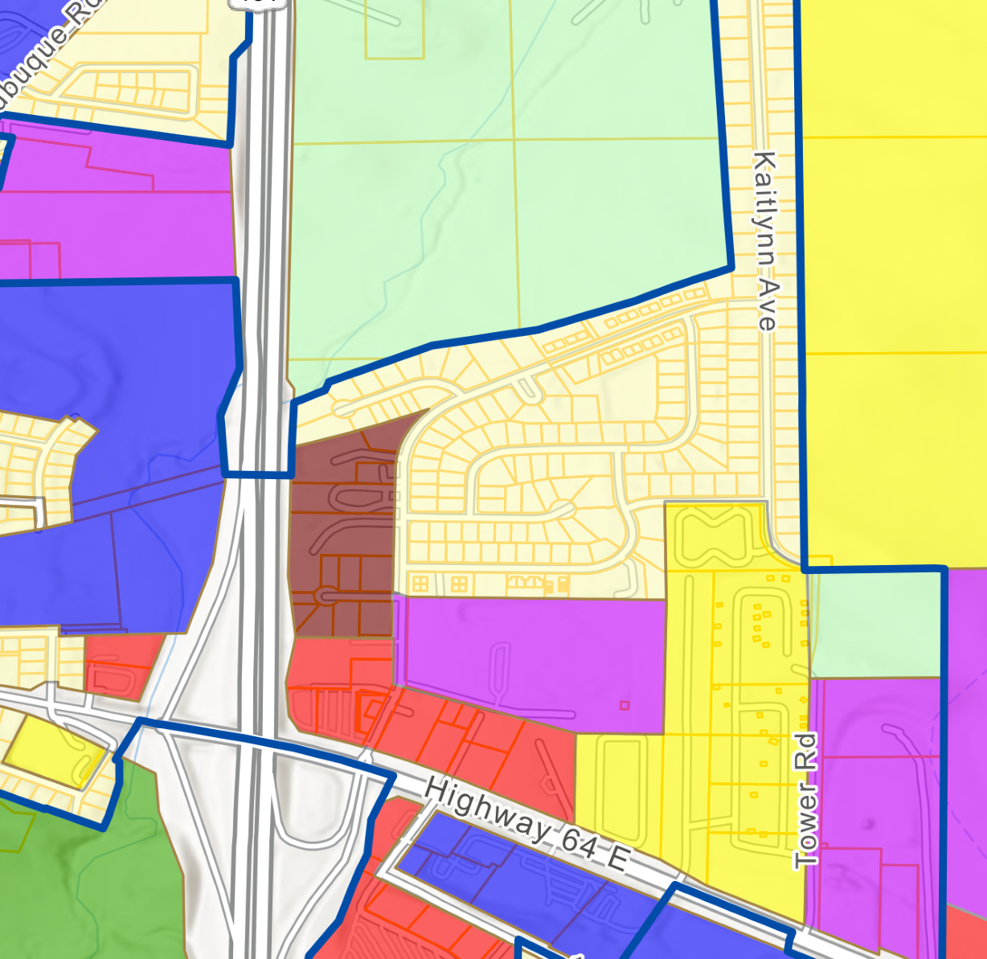
Planning Considerations
Tom Gruis

Slide 3
Comprehensive Plan Alignment​
Review plan guidance regarding the expansion of commercial and industrial uses.​
Review the future land use map. Does it identify areas appropriate for commercial or industrial development?​
Review plan guidance regarding economic development.​
Support for new commercial or industrial development may provide a stronger basis.​
Support for more jobs may provide a weaker basis.​
Review plan guidance regarding environmental impacts and natural resource protection.​

Slide 4
Zoning Considerations​
Do you have medium or large (2+ acre) greenfield or brownfield parcels already zoned for commercial or industrial use where a data center may qualify as a permitted use?​
Does your code require a site plan for large projects? ​
Does approval require action by the Board of Adjustment or City Council(non-administrative), which may allow conditions to be imposed?​
Site plan regulations, even under administrative review, may already address some of the impacts from data centers.​
Are the regulations sufficient for data center impacts?​

Slide 5
Options (Non-Exhaustive)​
Consult your attorney for any amendments to your code.​
Text Amendments​
Easier Updates​
Add a definition for “data center” if existing use definitions are vague or ambiguous.​
Consider moving a permitted use to a conditional use where appropriate.​
More Time Intensive Updates​
Amend the code to specifically address data centers and their unique impacts.​

Slide 6
Options (Non-Exhaustive)​
Zoning Map Amendment​
City-initiated rezoning: this is probably more appropriate for an undeveloped or vacant brownfield land, but some of the smaller changes above will likely be the better options. Consult the property owner and your attorney (be cautious of illegal spot zoning).​
A rezoning for a specific development proposal may provide clearer authority for development conditions and negotiations under Iowa law.​
Other Options​
Moratorium, temporary to allow for developing appropriate code​
Take no action if existing regulations adequately address data centers​

Slide 7
Other Considerations​
Consult your attorney.​
Continue to actively maintain and administer your comprehensive plan and development regulations. Communities that do so are generally better positioned to respond to emerging development types.​
Consider a fringe area plan and agreement with your county to improve land use planning and create clearer development review processes.​

Slide 8


Housing Considerations
Paula Mitchell

Slide 9
Housing Considerations
Identify current housing market conditions
  Does community have a current housing needs assessment?
  Does data show a surplus or deficit of housing units?
Identify short- and long-term housing needs
  Short term – potential for construction workforce
  Long term – jobs created
  Phasing of the workforce
Role of data center owner/developer in addressing housing needs resulting from the project
Standards for temporary housing, if applicable

Slide 10

Environmental Considerations
Alicia Presto

Slide 11
Environmental Considerations
Water, wastewater, and energy
Solid waste management (also requires regional approach)
Waste generated during construction, operations, and decommission
  Identify types and potential volume
  Identify solid waste and recycling services available
  Identify capacity of solid waste and recycling facilities
Waste reduction and recycling goals
Ordinances can include waste management planning requirements with range of requirements

Slide 12

Transportation Considerations
Mary Rump

Slide 13
Transportation Considerations
A traditional traffic impact study isn’t helpful because it doesn’t adequately address the temporary and significant traffic impacts during construction.
Construction traffic may have a significant impact on the existing infrastructure. May want to work with developers to identify preferred traffic routes to minimize wear and tear on existing roadways.
Construction will result in increased vehicular traffic. Both construction trucks and contractor vehicles. You may want to consider new turn lanes or temporary stop signs/traffic signals to maintain safe traffic flow
Many contractors may be coming from outside and unfamiliar with the area. Temporary signage may help with wayfinding.
Additional contractors in the area means additional demands for parking. Be sure to work with the developer to ensure that onsite parking is provided or city designated parking is identified.

