Slide 1
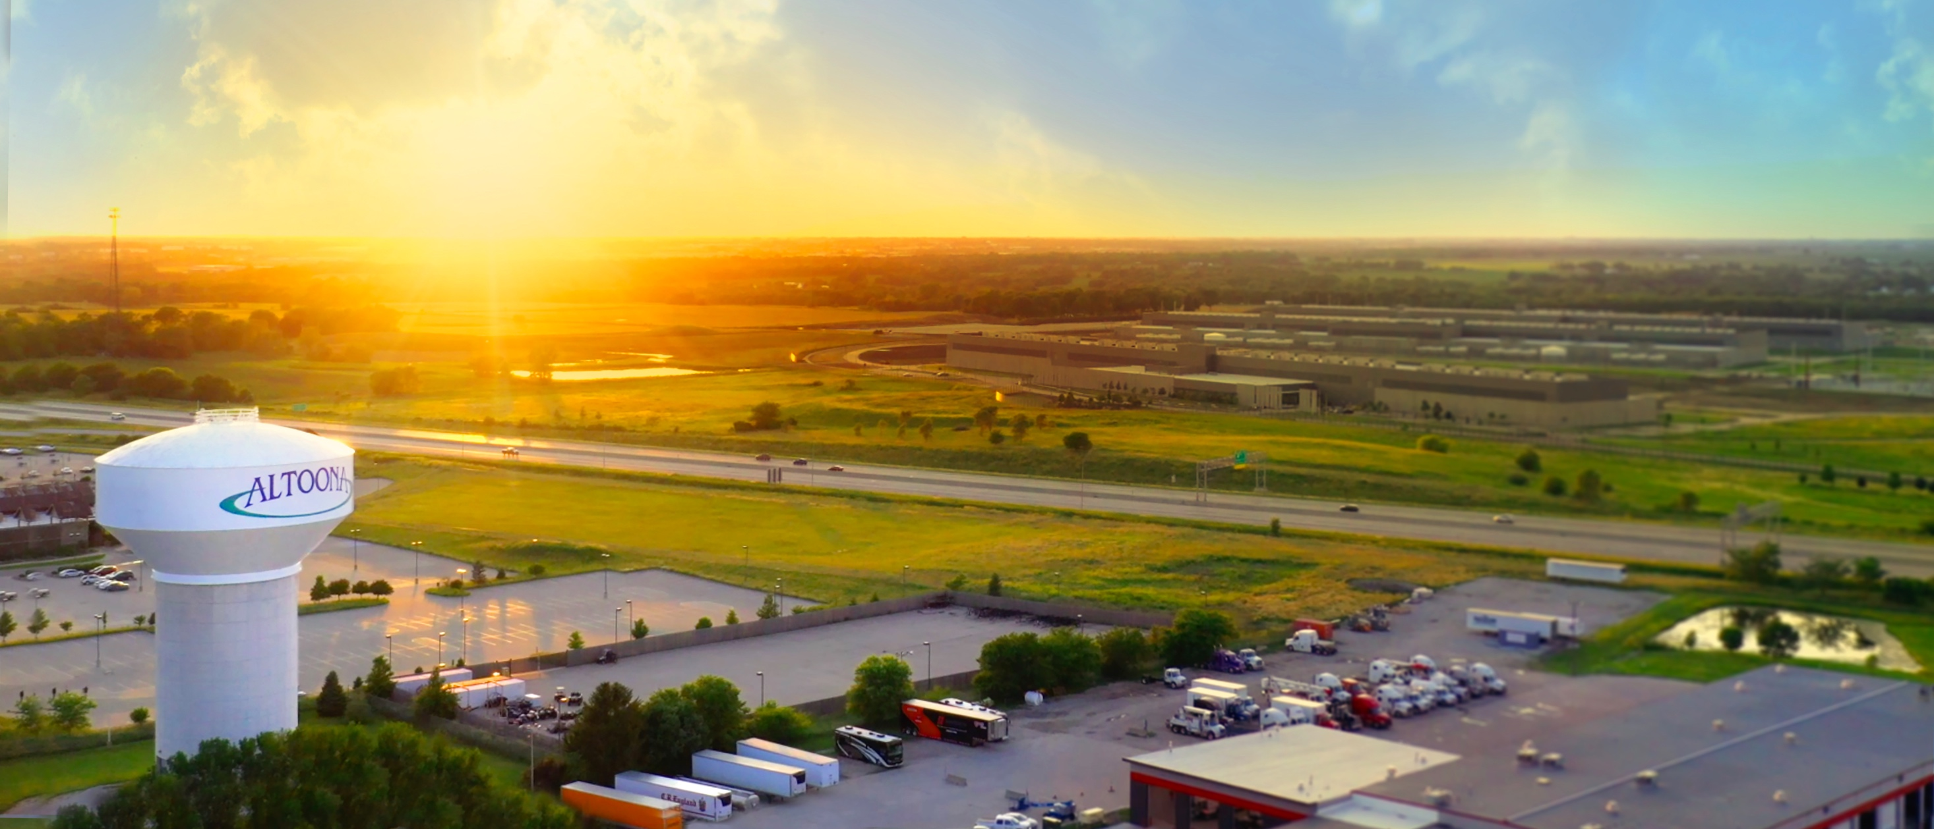

Data Centers and Community Growth
The Altoona, Iowa Experience

Slide 2
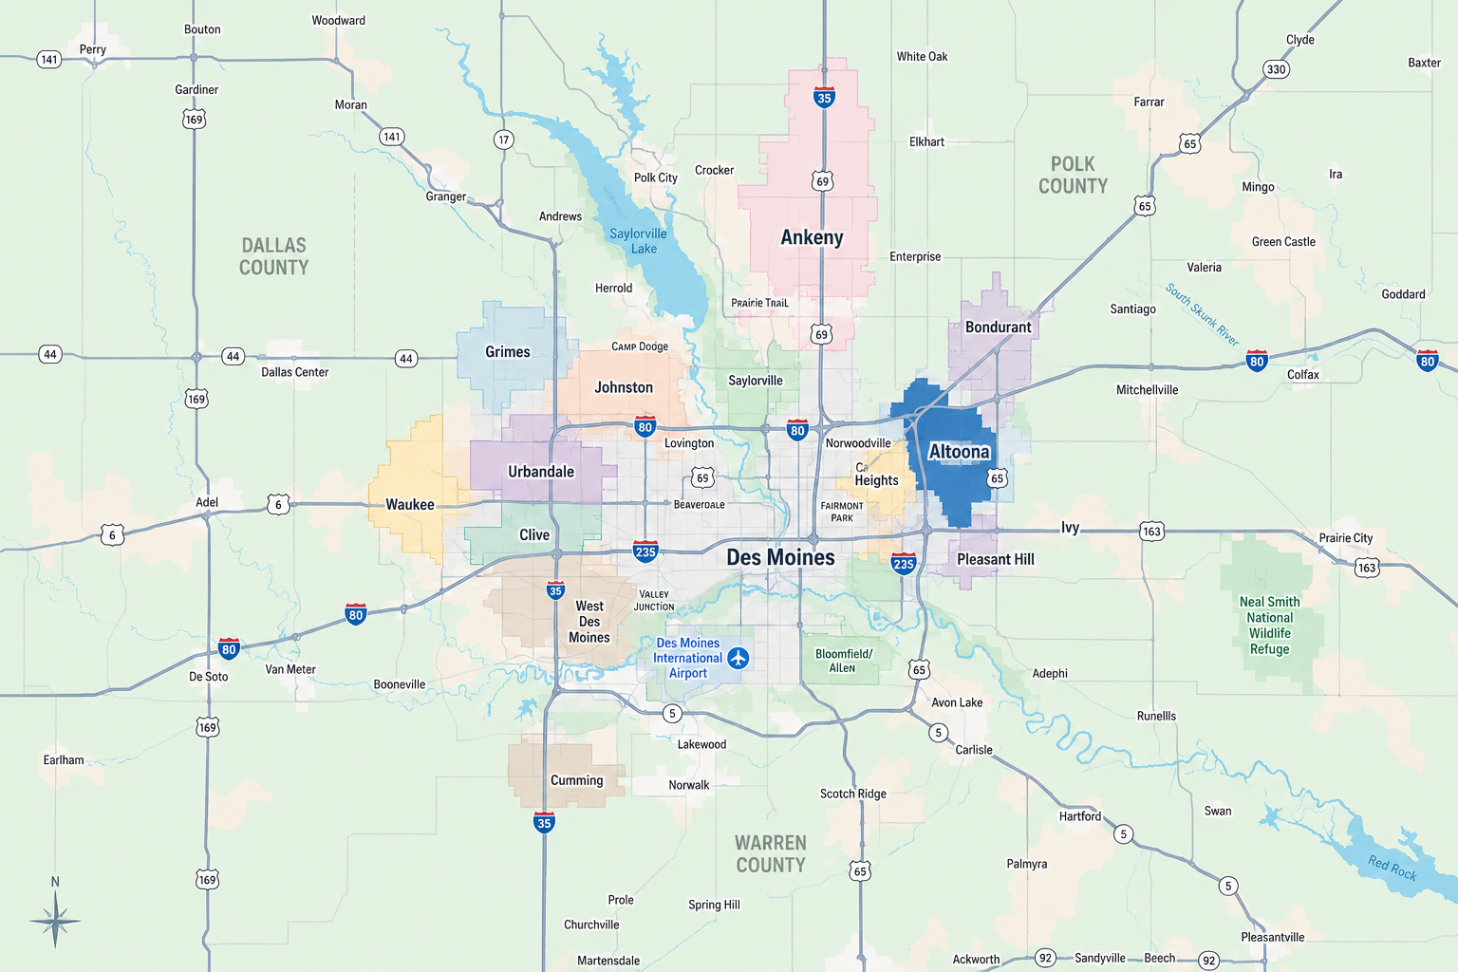

Slide 3
Altoona at a glance…
A Growing Community
Fast-growing suburb on the northeast side Des Moines
Recently completed a Special Census – 22,436 residents
  14% growth since 2020 ~ 19,567
  54% growth since 2010 ~ 14,541
Altoona has expanded its land area 73% since 2000, now totaling 16.2 square miles.
Home to Adventureland Resort, Prairie Meadows Hotel, Racetrack & Casino, Bass Pro Shops, and the Outlets of Des Moines.
Attract over 4 million visitors each year.
Generated over $715 million in retail sales last year.

Slide 4
Des Moines is the #9 data center hub in the U.S.
Reasons – low-cost and reliable power, land, fiber, water, etc.
Major technology investments from:
  - Meta
  - Microsoft
  - Apple
  - Other smaller data centers
Altoona is home to:
- Lightedge Solutions
- Meta – their world’s largest operational data center (5.5M SF)
- Cologix – purchased 80 acres
- Tract – purchased 450 acres

Slide 5
Why Data Centers Matter…
Digital infrastructure powers modern life
Data Centers house our economy and the way we live – emails, social media, Internet searches, banking, medical records, streaming services…
almost everything runs thru a data center.
In 2026, the average U.S. household has 20-25 Internet connected devices:
Smartphones, Smart TVs, tablets, laptops, smart watches, security systems, smart appliances, gaming systems, streaming devices, thermostats, lights, smart plugs, wi-fi extenders, etc.

Slide 6
Altoona's Data Center Journey
2005 - Lightedge Solutions establishes operations, expanded in 2017
2012 - Meta selects Altoona for major investment
Today - Data centers are a normalized part of the community landscape.

Slide 7
Lightedge Solutions – colocation data center
Key Facts:
- opened in 2005
- added a second building in 2017
- total of 73,000 SF in two buildings
- not one of our top 50 water users, use more for irrigation than inside their buildings.
- assessed at $15.5 million, paid about $537,000 in total property taxes last year.

Slide 8
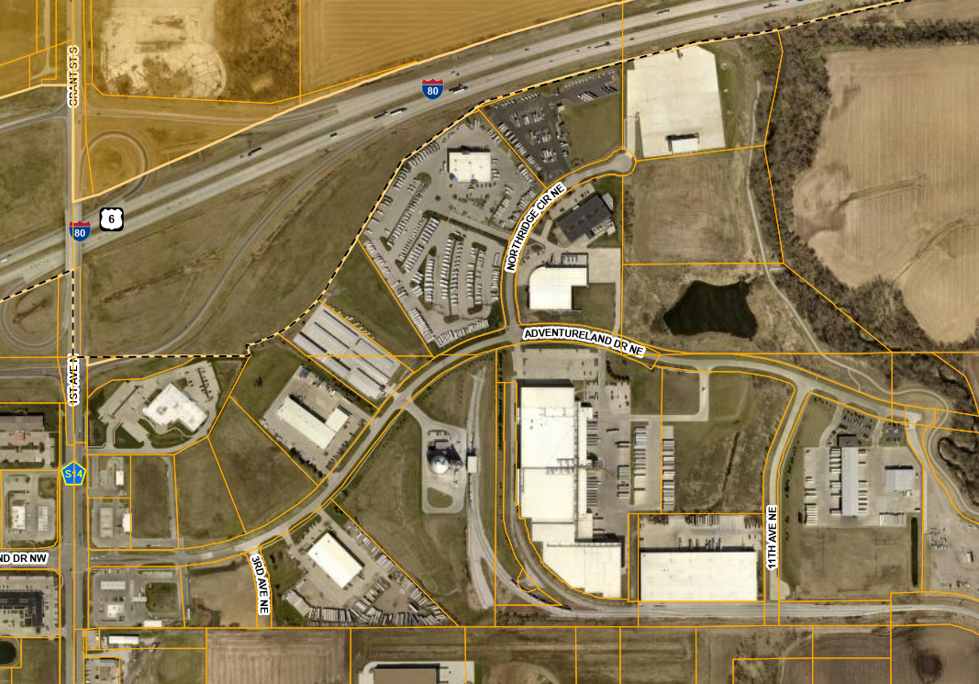
NE Industrial Park
Lightedge data centers

Slide 9
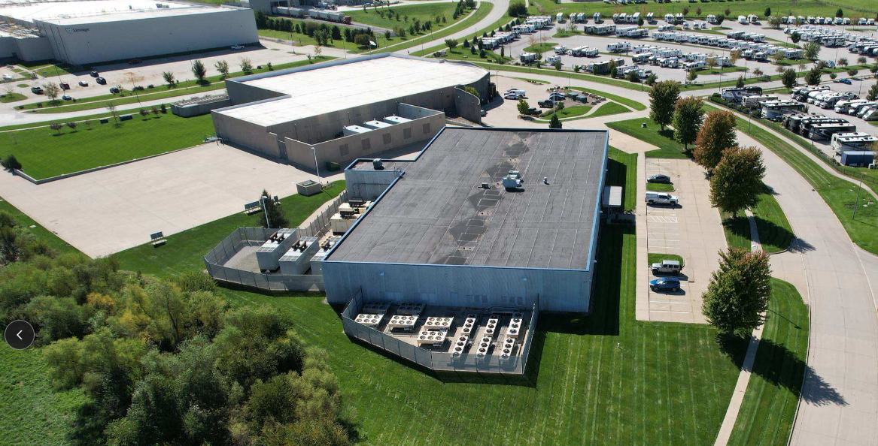
Drone image – looking southwest

Slide 10
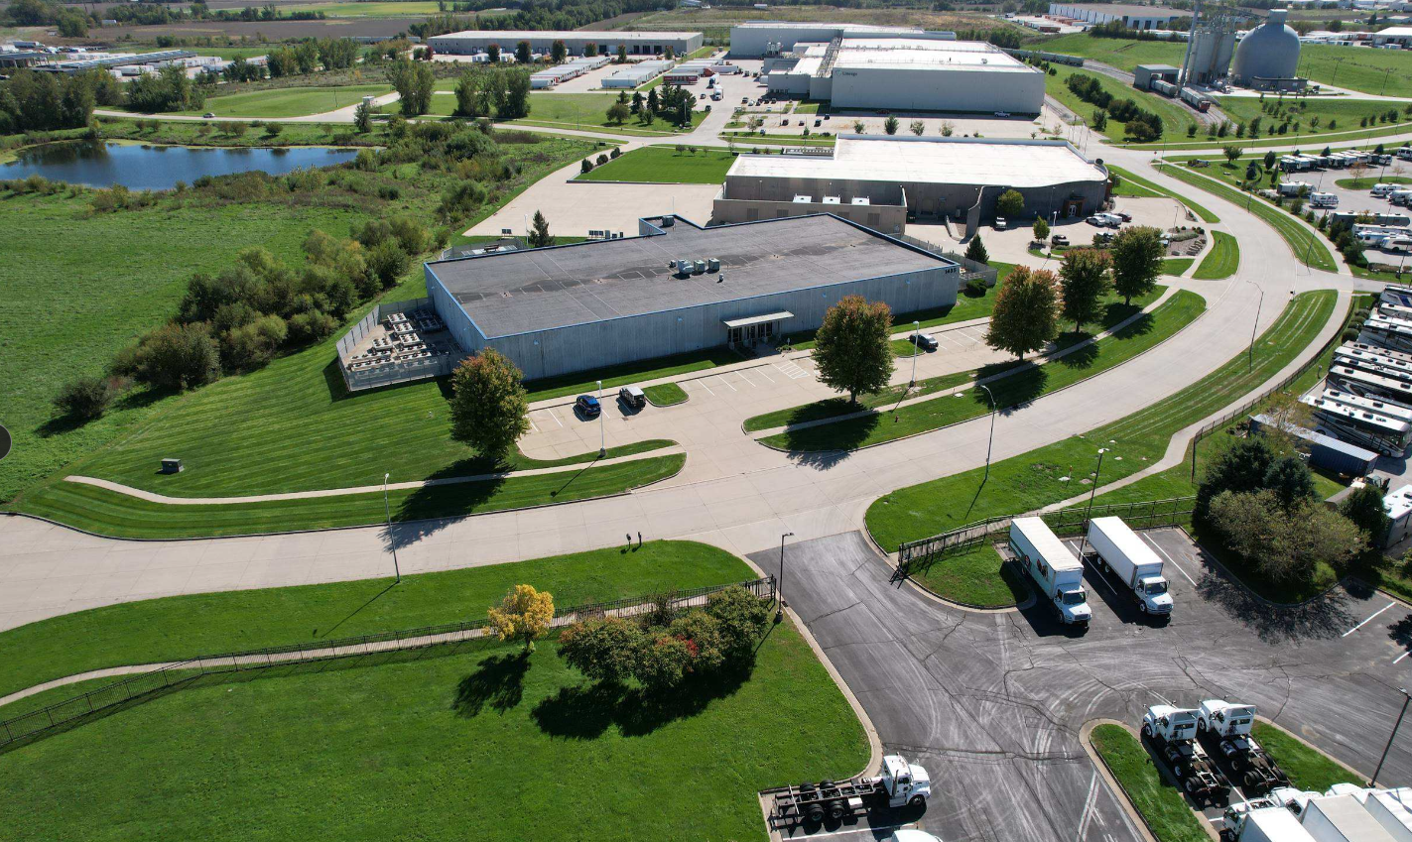
Drone image – looking south

Slide 11
Meta's Altoona Campus
Key Facts:
- Meta's largest operational data center campus in the world.
- 3.6 million square feet of ground-floor space.
- 5.5 million square feet including mezzanines.
- Expanded from an initial 185-acre purchase, now 603-acres in size.
- Paid about $26,000/acre initially. Last year, we had industrial land sell one-half mile north of Meta for $154,000/acre for 72 acres.

Slide 12
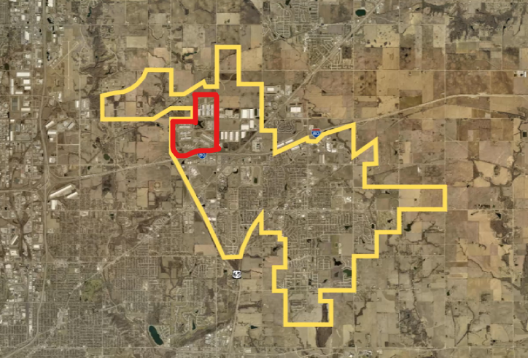
Altoona corporate limits, Meta campus highlighted

Slide 13
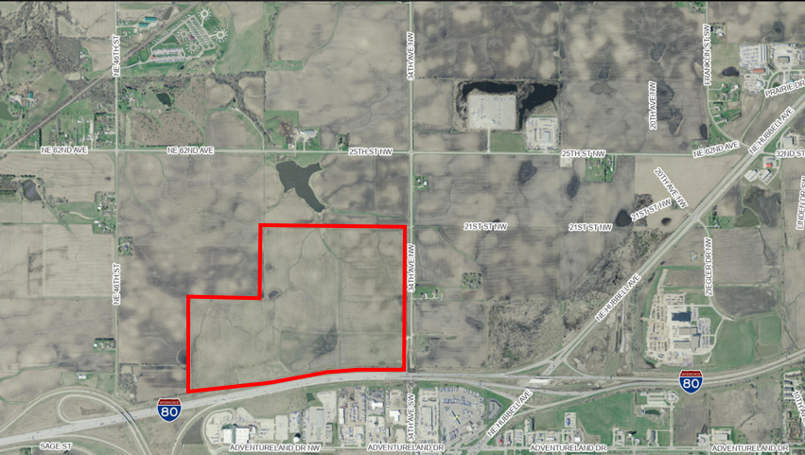
2013
Purchased 185 acres on the north side of I-80.

Slide 14
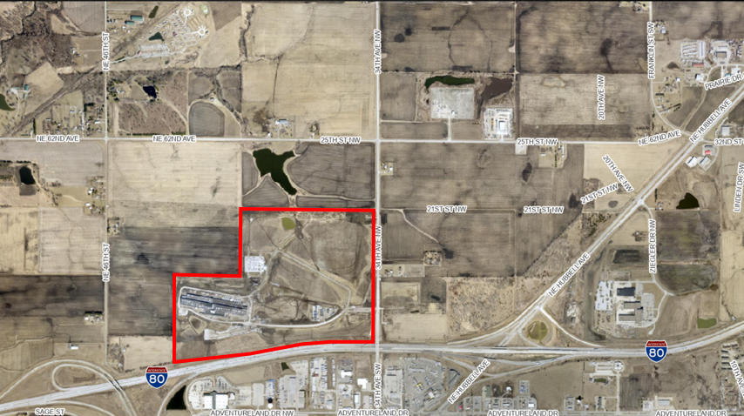
2014
Construction of first building = 312,000 SF

Slide 15
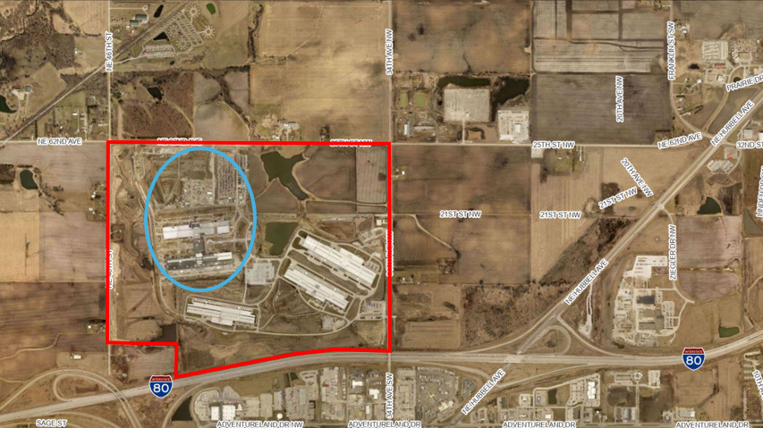
2018
Now have about 1 million SF constructed. Purchased additional land and started construction on their newest design that looks like a “H”, with a footprint of 600,000 SF each.

Slide 16
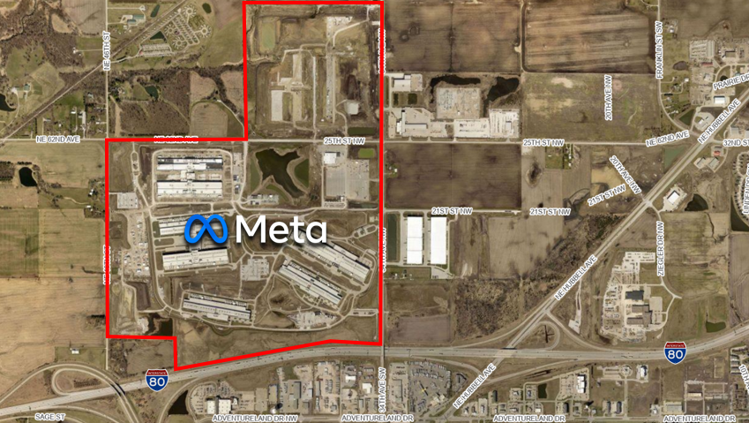
2021
Campus now consists of 603 acres.
Note some of the neighbors:
- Five residences share a property line
- A Century farm
- An RV park

Slide 17
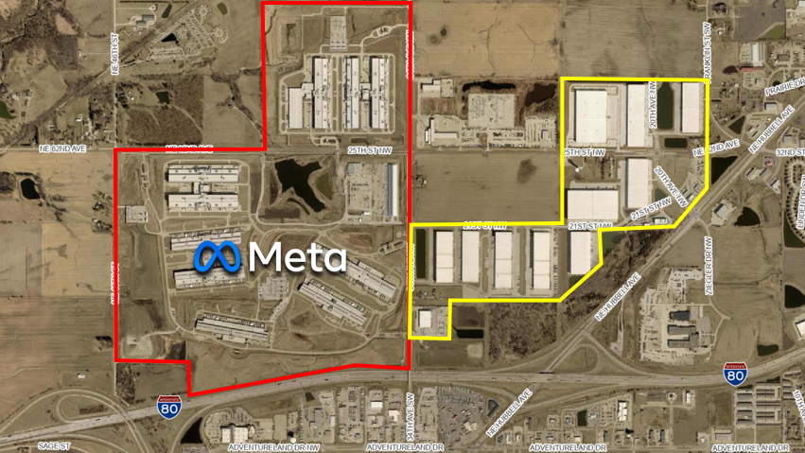
2025
Recently constructed
3.3 million SF of warehouse space (assessed at $385 M).

Slide 18
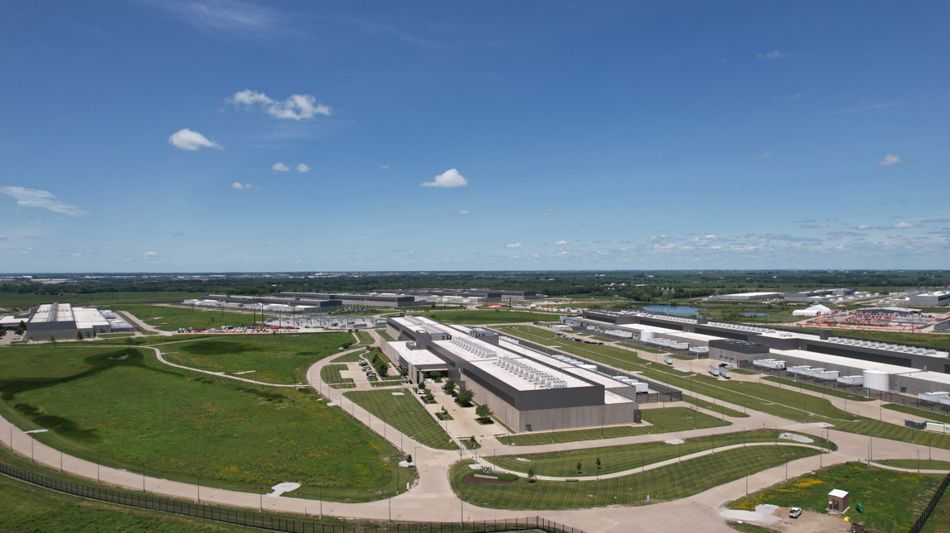
Drone image – looking west

Slide 19
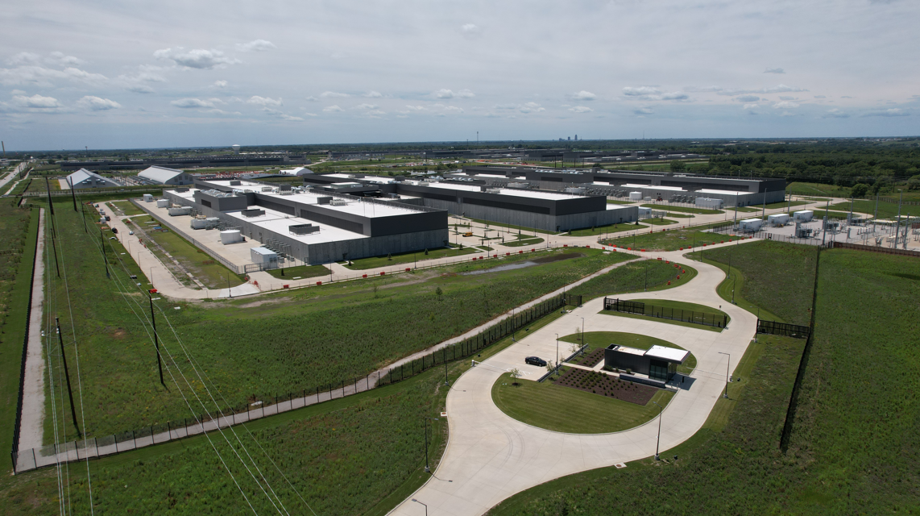
Drone image – looking southwest

Slide 20
Data Centers and Neighboring Development
Population around the Meta Campus: approximately…
  1,400 residents within 1 mile
  26,500 residents within 3 miles
  54,000 residents within 5 miles
Nearby Attractions – all within six-tenths of a mile of Meta:
Bass Pro Shops, Outlets of Des Moines, Adventureland Resort, Prairie Meadows Racetrack, Hotel & Casino.
Bass Pro Shops sits about a 0.25 miles from the nearest data center.

Slide 21
Light, Noise, Health, and Visual Impact
No noise complaints, they exercise generators but are enclosed.
No light pollution complaints – lights are motion activated.
No reports of any health issues or concerns – some Meta employees have worked inside these data center buildings since they began operations in 2014, and continue to work there.
Most of the Meta property is planted in prairie with trees added.

Slide 22
Neighbors Include:
A year-round RV park with 142 spaces, with plans to add 102 more… and all of them closer to the data center, and
18 single-family homes are within a quarter-mile.
Property value increases (adjacent neighbors):
 |  |  |  | Baseline |  | Assessed |  | Percent
Property | Size |  | Assessed | Assessment |  | Value |  | Increase
Identifier | (Acres) |  | Value | Year |  | 2026 |  | Since baseline
171/00055-016-000 | 0.92 |  | $ 153,500 | 2017 |  | $ 216,400 |  | 41.0%
171/00055-015-000 | 3.81 |  | $ 257,400 | 2017 |  | $ 403,900 |  | 56.9%
171/00055-032-000 | 1.30 |  | $ 261,300 | 2020 |  | $ 379,500 |  | 45.2%
190/00144-004-000 | 0.88 |  | $ 168,000 | 2017 |  | $ 281,200 |  | 67.4%
190/01640-005-001 | 1.20 |  | $ 191,300 | 2017 |  | $ 447,200 |  | 133.8% |  | bedroom addition in 2019

Slide 23
Altoona Water System
Altoona operates our own water treatment system.
In 1998, we opened our latest water plant and production capacity increased to 4 million gallons per day.
Since then, the …
Population has increased approximately 150% (9K to over 22K today).
Commercial development expanded significantly (Walmart, Target, Lowes, Menards, Hy-Vee, Bass Pro, Outlet Mall, water parks at Adventureland and the city, many car washes, and restaurants).
Industrial development expanded significantly (Meta, over 3 million SF of warehouse space, a cold storage facility, and others).

Slide 24
Today, in 2026, in the 28 years since our latest water plant opened in 1998, we still produce the same 4 million gallons of water each day.
The data centers have not had an impact on our ability to serve our growing residential demand or our new businesses.

Slide 25
Water Use in Context
Most people have no idea how much water is consumed in daily life.
Comparing Land Uses:
Meta Altoona Campus is 603 acres in size.
Equivalent residential development – at 3 housing units per acre, that equals 1,800 single-family homes that would fit in the same land area.
- Estimated water use: approximately 235,000 GPD.
The Meta Altoona facility uses about 65% of the water a similarly sized single-family residential subdivision would use.

Slide 26
Water Use Perspective - nearly every industry uses water
Examples: Food processing facilities, manufacturing plants, cold storage facilities, hotels and casinos, amusement parks, etc.
Meta is not Altoona’s largest water user - that user is a small food production plant that makes dressing, sauces, and pastas (sits on about 10 acres in the middle of Altoona). Additionally, 30-40% of all water used in Altoona in the warmer months is for lawn irrigation.

Slide 27
MidAmerican Energy is our utility provider
(they produce a one-pager about data centers)
They report improved system reliability, enhanced infrastructure, and long-term capacity planning.
Large industrial customers, such as data centers, are required to fund the power and infrastructure needed to serve them, such as substations and transmission upgrades. Those costs are not passed on to existing customers.
Additional Protections for new data center projects:
- Load commitment agreements
- Exit penalties

Slide 28
Power and Grid Benefits
Infrastructure Investments Benefit Everyone
Meta electricity use is matched with 100% clean and renewable energy.
About 65% of Iowa’s electricity generation comes from renewable sources, with about 63% being from wind alone.
Data center development has funded:
- Transmission system upgrades
- Grid reliability improvements
- Expanded electrical capacity

Slide 29
Economic Impact
Meta received a 20-year tax abatement on the buildings, not the land.
Abatements begin to expire in 2033
Have always paid taxes on the land
Pay a sizeable PILOT - $8.1 million in 2026
Have contributed approximately $5.4 million in community grants to schools, non-profits, libraries, clubs, events, organizations, etc.
Are a huge supporter of skilled trades both at the local high school level and at the community college level.
Public infrastructure investments.

Slide 30
Economic Impact, continued…
Meta Campus Valuation:
Approximately $1.3 billion today
Potential Annual Property Tax Impact (if full taxes were paid today):
- Approximately $19 million each year to the school district
Approximately $13 million each year to the City
Total property taxes paid would be about $43 million

Slide 31
Jobs and Workforce Impact
Employment
- Meta Campus: support 400+ permanent employees.
- Ongoing maintenance and operations workforce.
- Up to 1,300 construction workers each day during peak of construction, and have not stopped at least some form of construction or remodeling since 2013.
Long-Term Value
Data centers create:
Direct jobs
Skilled trades opportunities
Supplier relationships
Regional economic diversification

Slide 32
Infrastructure and Economic Multipliers
Beyond the Data Center
Data center investments helped fund:
- Larger water mains in the area.
- Majority funder of a new water tower in the NW industrial area.
- Paid for a 2.5-mile long sanitary sewer trunk main that opened approximately 5 square miles for future development.
Have invested over $11 million in public infrastructure
Catalyst Effect
Infrastructure improvements have attracted additional private investment and industrial growth.

