Slide 1
Nuisance Inspection Services
Junk and Junk Vehicles
Solid Waste Control and Recycling
Weeds and Grasses
Dangerous Buildings
Building Numbering

Slide 2
Working with communities for Nuisance enforcement
Communicate expectations that the city may have
  Are you having issues with a specific problem?
    Junk Vehicles
    Overgrown weeds or trees
    General trash
Is the city council prepared to enforce the nuisance letters?

Slide 3
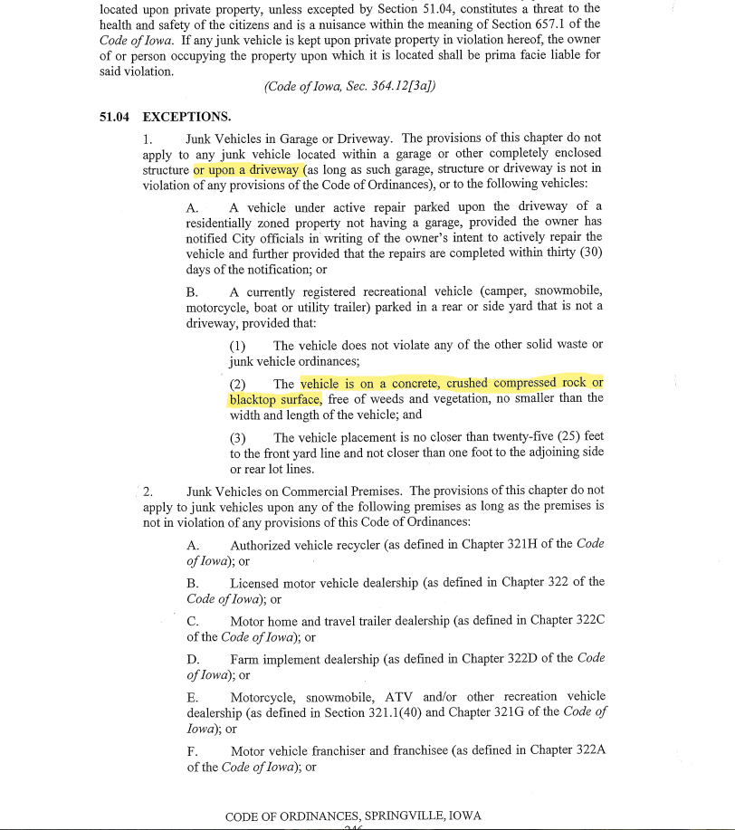
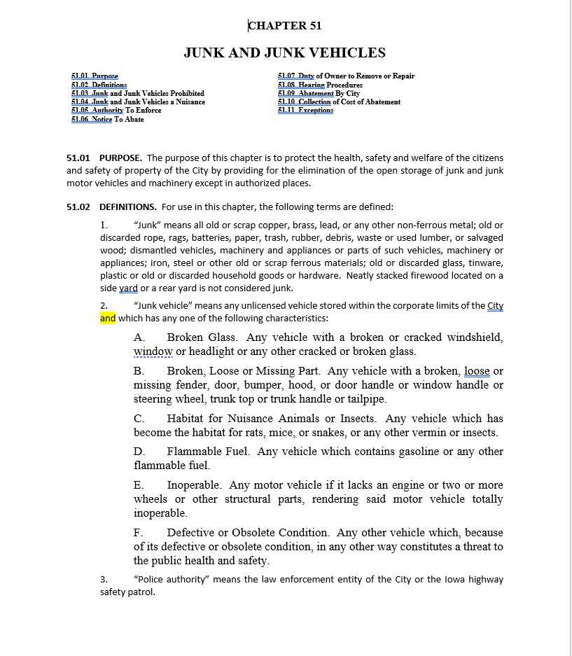
Working with communities for Nuisance enforcement
Look through the city nuisance chapters for enforcement
  What makes a nuisance
  Are there exceptions
  Time given to comply

Slide 4
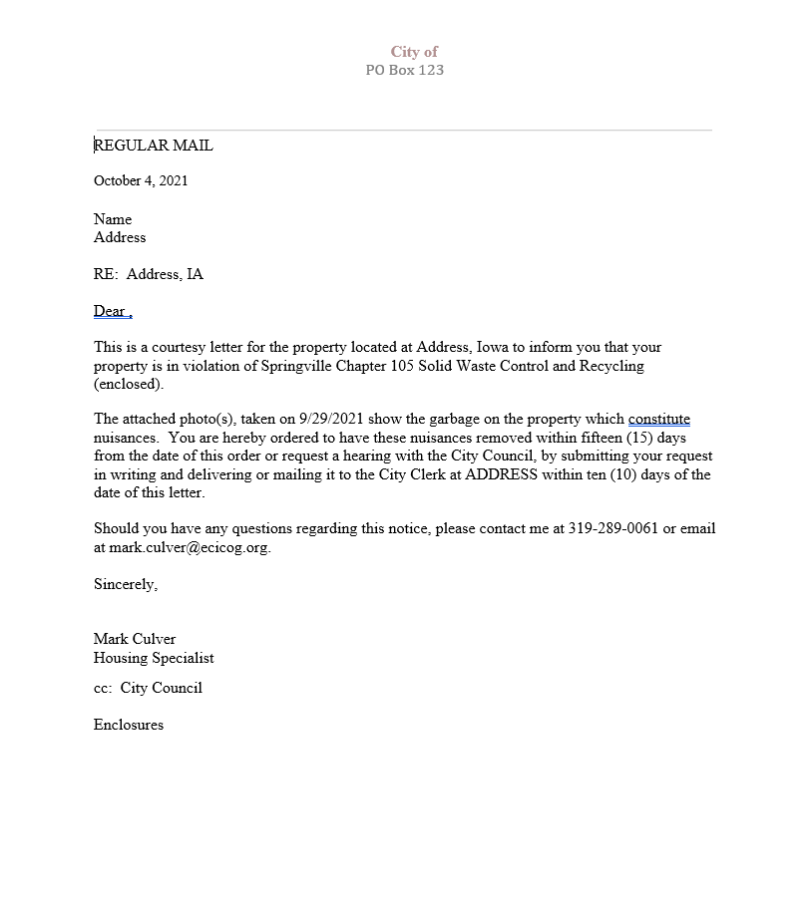
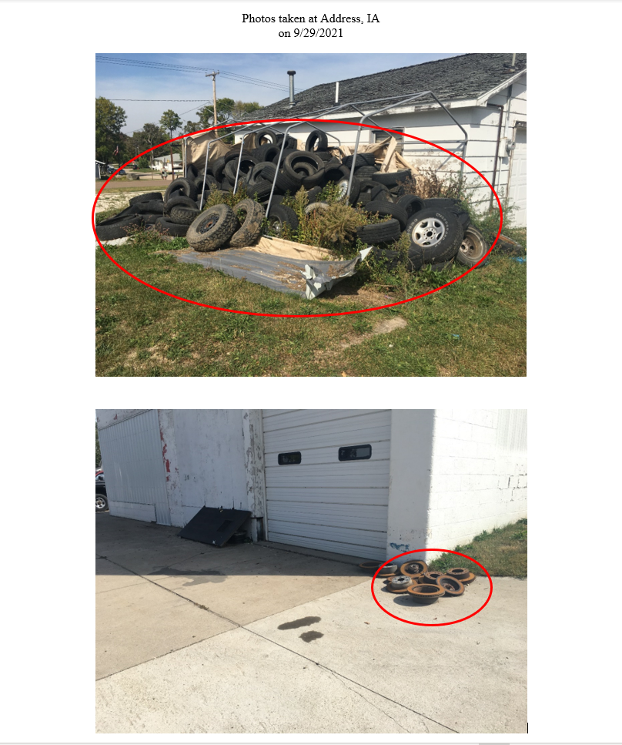
Working with communities for Nuisance enforcement
Inspect homes for Nuisances
  Any properties identified by the city?
  Drive the streets looking for nuisance violations
  Take clear photos to identify the nuisance
  Prepare nuisance letters and photo pages
    Use city letterhead
  Send the documentation to the city for approval to mail
  After city approval, mail the letters out
    Regular mail
    Certified mail
Reinspect homes after sufficient time has passed for correction

Slide 5
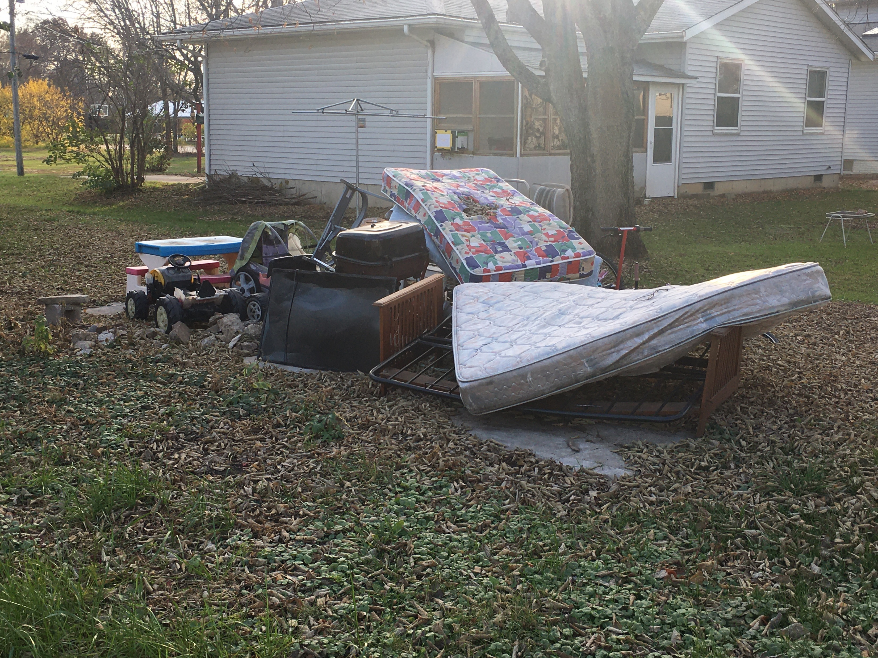

Slide 6
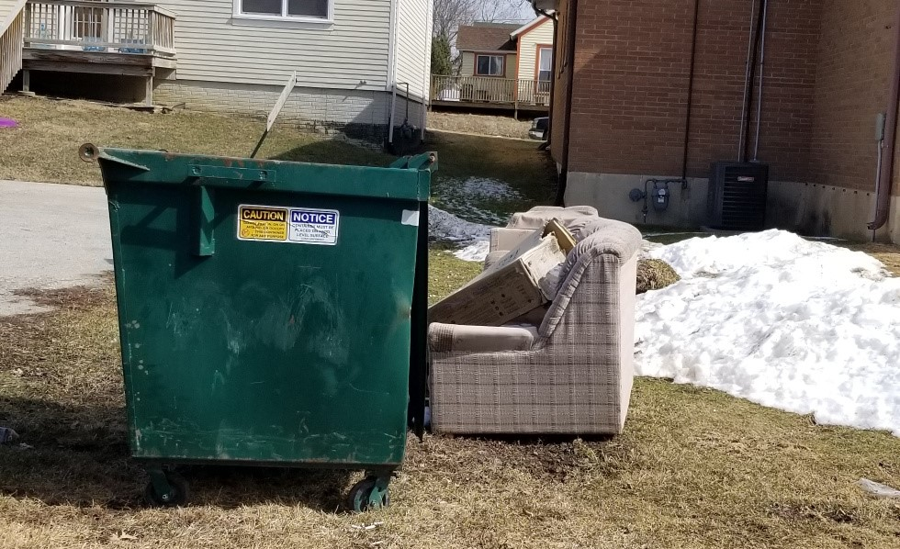

Slide 7
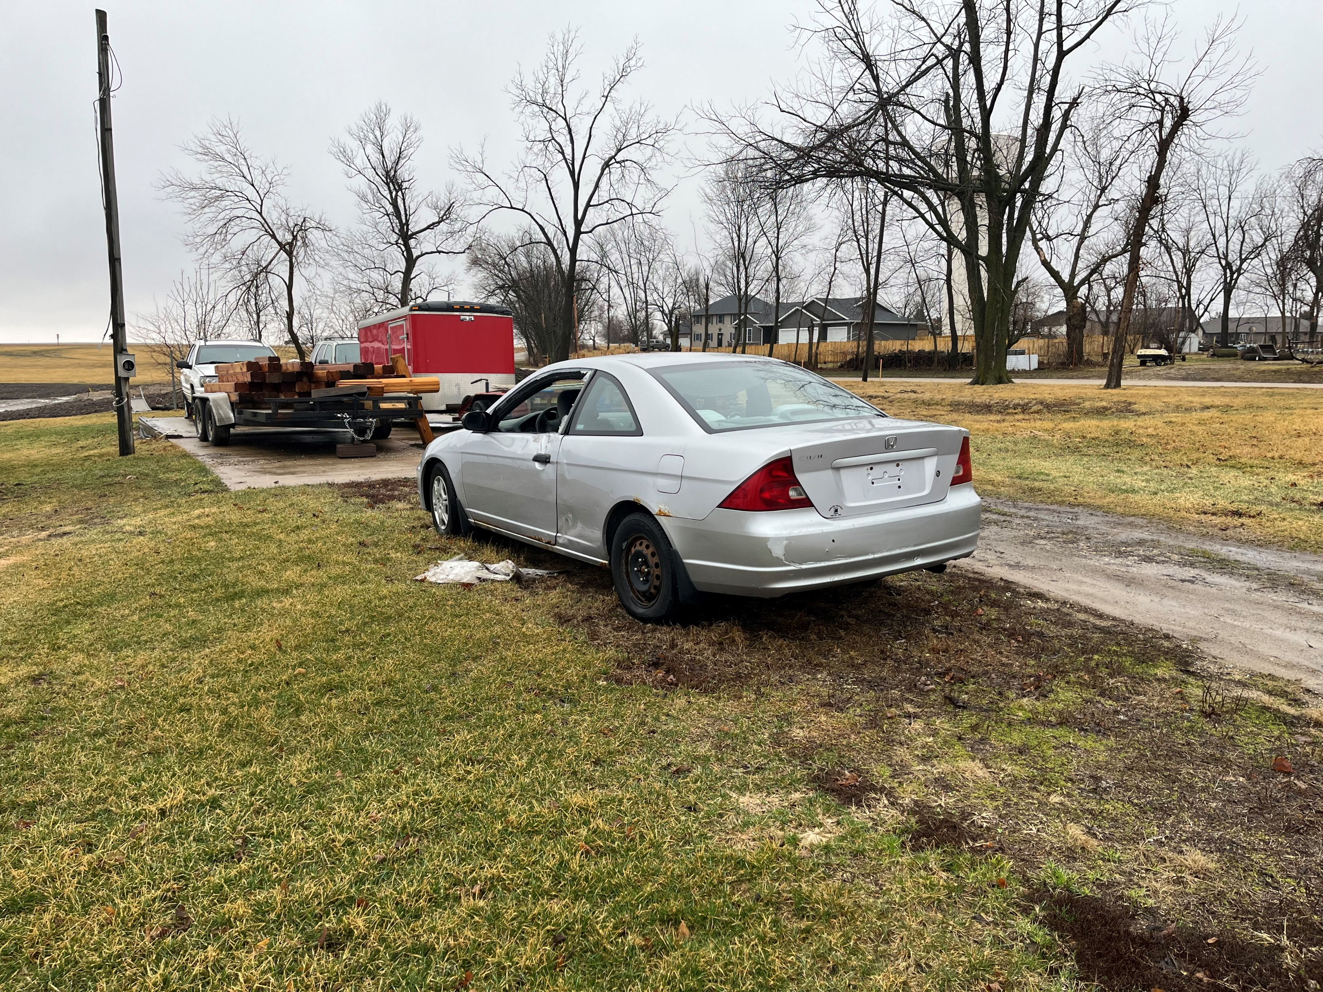

Slide 8
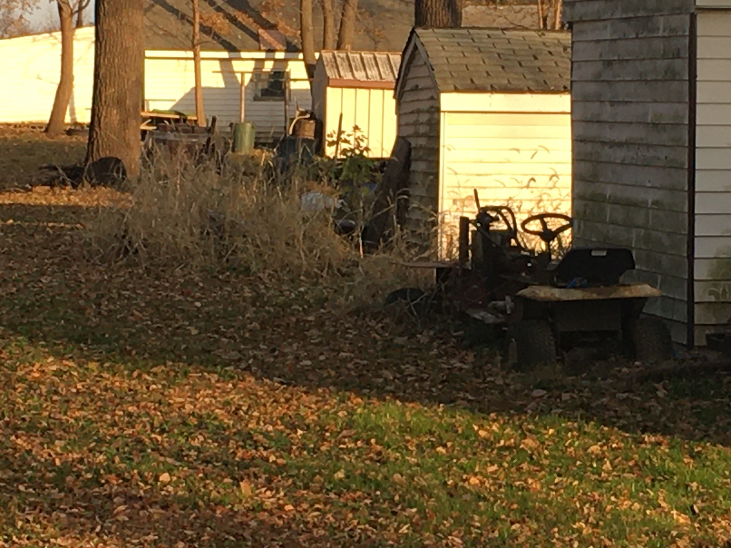

Slide 9
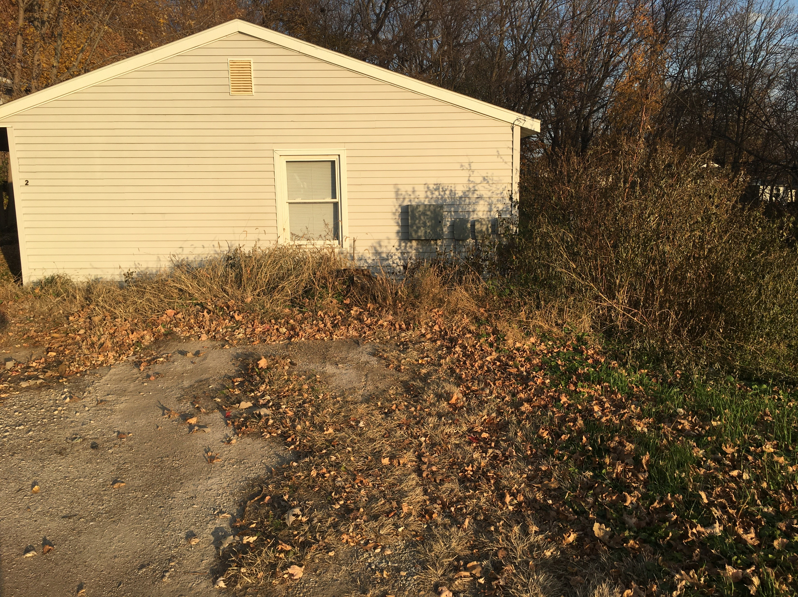

Slide 10
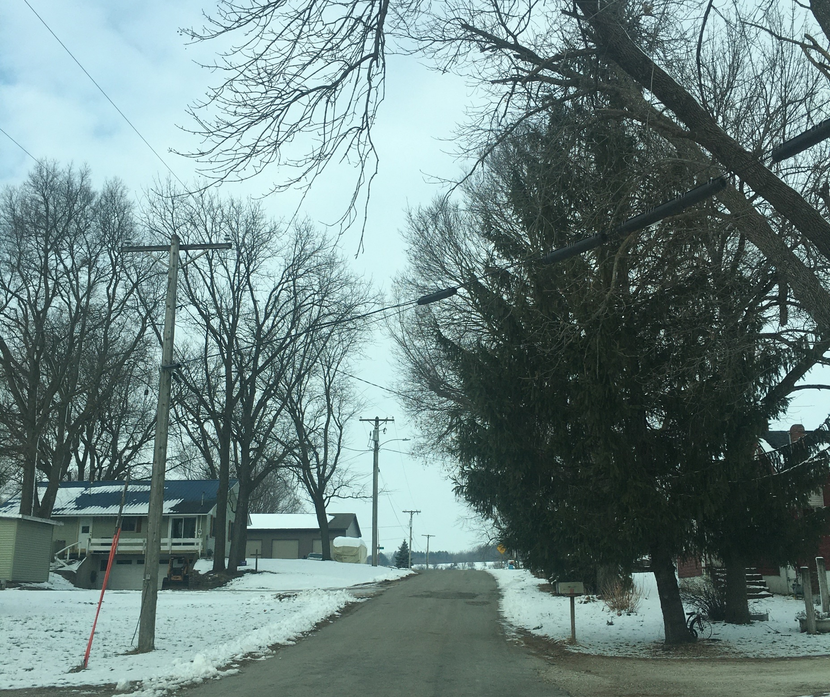

Slide 11
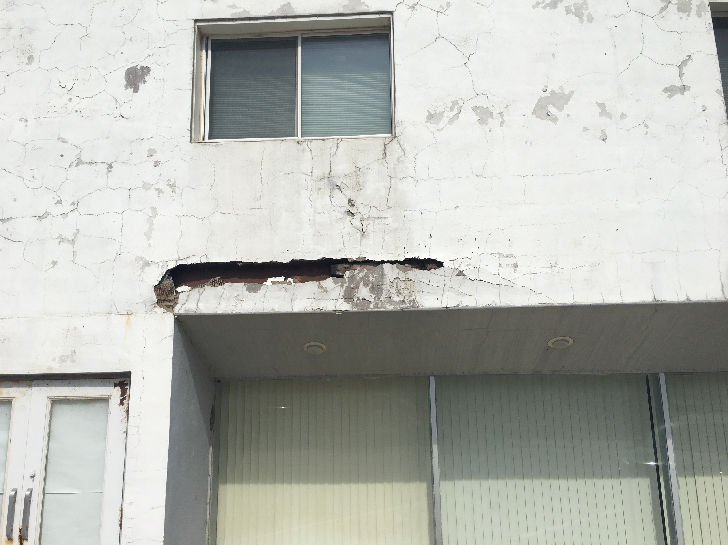

Slide 12
Nuisances:
Proactive Enforcement
ECICOG and Staff Review Existing Codes and Develop Enforcement Plan
ECICOG Begins Enforcement Based on City Priorities and Allotted Hours
ECICOG Investigates and Writes Follow Up Reports as Issues are Identified in the Field
ECICOG Issues Citations and Conducts Follow Up Inspections
Process Repeats for Subsequent Citations
City Staff/Attorney is Responsible if Court Action is Required
ECICOG Emails Monthly Progress Report to City
$5400/year. Estimated 3 hours onsite/3 hours office monthly. May be able to reduce hours as program is established.
Billed $900 bi-monthly.

